Slide 1
Corporate Compliance
Heather Marcum

Slide 2
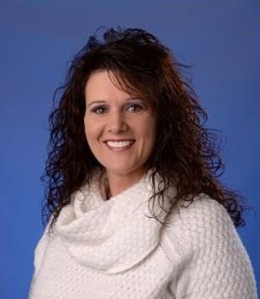

Corporate Compliance and Integrity Team
Heather Marcum
Executive Director/
Compliance & Privacy Officer
x80161
Tonia Hall
Compliance & Privacy
Manager
x84451

Slide 3

What is a Corporate Compliance program?
Corporate Compliance refers to King's Daughter's program to ensure King's Daughters complies with:
Federal, state and local laws
Federal healthcare program requirements
The Code of Conduct
King's Daughters policies and procedures

Slide 4
Our Corporate Compliance Program
Demonstrates to the community King's Daughters commitment to corporate citizenship
Reinforces King's Daughters culture of ethics, integrity accuracy to all team members and provides guidelines for leadership compliance responsibilities
Provides an expectation of team member, provider and contractor behavior
Provides procedures to correct misconduct
Provides effective communications for Board of Directors through an organized framework for regulatory compliance tracking and reporting
Protects the financial viability of King's Daughters
Mitigates sanctions which may be imposed by the government
Ensures King's Daughters provides the highest level of quality care
Protects the Protected Health Information (PHI) of the patients

Slide 5
Seven Elements of the OIG Model Compliance Program
Policies and Procedures
Compliance Officer and Compliance Oversight
Screening Employees, Contractors, Physicians, Board Members
Education
Auditing and Monitoring
Corrective Actions to Identified Problems
Enforcement of Violations

Slide 6
Compliance & Integrity Committee
It is important you know representatives of the below departments are members of the Compliance & Integrity Committee. They are available to you as a compliance resource.
Revenue Cycle
Kingsbrook
Kings Daughters Ohio
Medical Practice Services
Radiology Services
Laboratory Services
Legal
Human Resources
Internal Audit
Environmental / facility operations
Social Work
Administration
Quality
Home Health
Behavior
IST Security
Transition of Care Services

Slide 7
Code of Conduct
King's Daughters Code of Conduct provides the principle guidelines to conduct daily business activities ethically and legally.
The Code of Conduct is the “Constitution” of King's Daughters Compliance & Integrity program and is designed to assure King's Daughters meet compliance goals.
Each of us has a role to play and can make a real difference. We have individual responsibility and accountability to follow King's Daughters policies and procedures, Code of Conduct, Federal health care program requirements, and to conduct activities in an ethical manner.
The Compliance Handbook contains King's Daughters Code of Conduct. Review the Code of Conduct and ask questions if you do not understand what is expected of you.

Slide 8
Code of Conduct
The Code of Conduct must be observed by everyone:
Team Members
Leadership Team
Board of Directors
Medical Staff and Allied Health Professionals
Vendors and Contractors
Students
Volunteers

Slide 9
Conflicts of Interest
A Conflict of Interest arises in the workplace when a team member has competing interests or loyalties that either are, or potentially can be, at odds with each other.
King's Daughters expects its Team Members, Medical Staff Members, Volunteers and Contractors and Vendors to exercise attention, good judgment and prudence in their relationships, obligations and financial interests so that they do not conflict with the interests of King's Daughters or the performance of their duties.
Review King's Daughters policy and procedure on Conflicts of Interest.
Team Member’s are obligated to report potential conflicts of interest:
  upon hire / on boarding process (conducted by HR)
  Anytime a conflict develops
  During annual general compliance training
Examples of potential conflicts:
  Provide consulting services to competitor
  Directly supervising a close family member or in a position to make decisions
  to benefit the family member

Slide 10
Fraud, Waste, & Abuse
Healthcare is a government enforcement priority because of the potential for fraud, waste and abuse.
Fraud is making material false statements or representations of facts that an individual knows to be false or does not believe to be true in order to obtain payment or other benefit to which we would otherwise not be entitled
Abuse are practices that directly or indirectly result in unnecessary costs or improper payments for services which fail to meet recognized professional standards of care
Waste is overutilization of services or other practices that, directly or indirectly, result in unnecessary costs to the health care system, including the Medicare and Medicaid programs.
The Federal False Claims Act governs violations of Federal health care program requirements.

Slide 11

Fraud, Waste, & Abuse
King’s Daughters is committed to preventing, detecting, and correcting fraud, waste, and abuse within our operations.
All team members have an obligation to report possible compliance violations to the Compliance & Integrity Department.
Team members also have the ability to report possible violations of the False Claims Act (FCA) directly to the Federal Department of Justice as a qui tam (also known as whistleblower) relator.

Slide 12
Federal False Claims Act
The False Claims Act provides for civil liability for individuals and organizations that knowingly submit, or cause the submission of, false claims to the Federal Government.
Examples include, but are not limited to, claims for services that:
  Have not been provided
  Are not supported by documentation in the patient’s medical record
  Are paid or being paid by another claim
  Are incorrectly coded

Slide 13
Overpayments
The Affordable Care Act requires that a person (e.g., provider, hospital, medical office) who received a Medicare or Medicaid Overpayment to report and return the Overpayment.
What is an Overpayment?
A Medicare or Medicaid overpayment is “any funds that a person receives or retains to which the person, after applicable reconciliation, is not entitled.”
Examples of Overpayments include, but are not limited to, the following:
  Billing the wrong level of care for an office visit;
  Separately billing services which should have been bundled into one bill;
  Billing for an MRI when a CT was performed;
  Billing for a service which was not properly documented; or
  Billing for a service which was not medically necessary.

Slide 14
Overpayments
It doesn’t matter if an Overpayment is a mistake or not intentional. If Medicare or Medicaid paid an excess amount, an Overpayment occurred.
An overpayment must be reported and returned no later than sixty (60) days after the date on which the Overpayment was identified.
Failure to report an Overpayment may result in liability under the False Claims Act.
If you suspect an Overpayment has occurred, immediately contract your supervisor or the Compliance and Integrity Department.

Slide 15
Overpayments
To reduce the chance that an overpayment could be made, King’s Daughters takes these actions:
Monitoring
National and Local Coverage Determinations
National and Local Coverage Determinations identify Medicare’s payment and coverage criteria for certain tests and procedures. Many of these National and Local Coverage Determinations are ‘built’ in EPIC and generate prompts when entering a test or procedure.
Audits
Audits are performed by Internal Audit, Compliance & Integrity, and external contractors.
Reporting
Team members are required to report any suspected concern with billing activities which may result in overpayment. Reports can be made using any of the available reporting methods.
Billing functions for professional, hospital, and home care services are regularly monitored by applicable departments.

Slide 16
How do I report suspected compliance violations?
All King's Daughters team members, providers, and contractors/vendors are required to report concerns about actual, potential or perceived misconduct to the Compliance & Integrity Department. One may use any of the following reporting tools:
Call the Compliance Hotline at (606) 408-4145 or (877) 327-4145
Call the Lighthouse Services Hotline at (844) 940-0003 which is an independent third-party hotline provider contracted by King's Daughters as an additional anonymous reporting tool
Complete the Compliance Concern Form found on the intranet
Contact Executive Director/ Compliance & Privacy Officer, Heather Marcum (606-408-0161)
Contact Compliance & Privacy Manager, Tonia Hall (606-408-4451)
Contact your supervisor, director or Vice President
Email corporatecompliance@kdmc.kdhs.us (not anonymous)
Send written correspondence intercompany to 2201 Lexington Avenue, Ashland, KY 41101
Attn: Compliance & Integrity Department

Slide 17
What kinds of things should I report?
Violations of the law (Federal, state or local)
Violations of the Federal healthcare program requirements
Inappropriate gifts, entertainment or gratuities
Discrimination
Workplace or sexual harassment
Hostile work environment, bullying
Stealing/misused of King's Daughters assets
Billing or coding concerns
Documentation issues
Violations of patient confidentiality (can be reported to Heather Marcum or Tonia Hall)
Violations of the Code of Conduct
Violations of policies and procedures
Potential conflicts of interest

Slide 18
How does KD prevent violations of the False Claim Act?
King’s Daughters established a comprehensive compliance program through the establishment of the Compliance & Integrity Department.
Here are some examples of compliance program activities
  Internal Audit’s auditing efforts
  Compliance & Integrity Department’s monitoring and auditing compliance plan
  Contracting with external resources to provide reviews
  Revenue Cycle’s data mining and monitoring
  Leaders’ self-monitoring their department risks;
  Annual Compliance Risk Assessment
  Review of the Office of Inspector (OIG) Work Plan which identifies risks
  Follow up on concerns reported to the Compliance &
  Integrity Department

Slide 19
Inducements
The OIG has interpreted the prohibition on inducements to permit Medicare or Medicaid providers to offer beneficiaries inexpensive gifts (other than cash or cash equivalents) or services without violating the statute.
For enforcement purposes, inexpensive gifts or services are those that have a retail value of no more than $15 individually, and no more than $75 in the aggregate annually per patient.

Slide 20
Guidelines for Gifts and Gratuities
Team members and contracted employees are prohibited from soliciting tips, personal gratuities or gifts from patients or vendors
Team members may accept unsolicited business courtesies from vendors, excluding cash, up to a value of $50.00
Any business courtesy from a vendor in excess of $50.00 in value must be approved by Compliance and Integrity Department in advance of team member acceptance
Team members and contracted providers may accept an unsolicited gift from a patient or a patient’s family member of nominal value (i.e, having a value of less than $100.00)

Slide 21
Disruptive Behavior, Workplace Harassment and Sexual Harassment

Slide 22
King’s Daughters strives to maintain a workplace that fosters mutual team member’s respect and promotes harmonious, productive working relationships. In providing a productive working environment, King’s Daughters believes that its team members should be able to enjoy a workplace free from all forms of discrimination, including harassment on the basis of race, color, religion, gender, national origin, age, disability, veteran status, uniformed service, marital status, pregnancy, sexual orientation, gender identity, or any other status or characteristic protected by law.
It is King’s Daughters policy to provide an environment free from such harassment.
It is a violation of policy for any team member, whether a manager, supervisor or co-worker, to harass another team member. Harassment of third parties by King’s Daughters team members, or harassment by third parties of King’s Daughters team members, is also prohibited.
Please report suspected or violations to the Human Resource Department, supervisor, manager, director, or to the Compliance and Integrity Department.

Slide 23
Reporting inappropriate behavior
If you feel that you are being bullied, discriminated against, victimized or subjected to any form of harassment:
DO
  Firmly tell the person that his or her behavior is not acceptable and ask them to stop. You can ask a person you trust, such as a supervisor or team member to be with you when you approach the person.
  Document the events in RL6 reporting system. Record:
    The date, time, and what happened in as much detail as possible
    The names of witnesses
    The outcome of the event
  Remember, it is not just the character of the incidents, but intent of the behavior and the number, frequency, and especially the pattern that can reveal bullying or harassment.
  Keep copies of any letters, memos, e-mails, etc., received from the person.
  Please report suspected or violations to the Human Resource Department, supervisor, manager, director, Risk Management Department, or to the Compliance and Integrity Department.
  If your concerns are minimized, proceed to the next level of management.

Slide 24
Do not:
DO NOT RETALIATE. You may end up looking like the perpetrator and will most certainly cause confusion for those responsible for evaluating and responding to the situation.

Slide 25
Responsibilities and Rights
Right to harassment-free workplace
Responsibility to treat all team members, suppliers, contractors, patients, and providers with respect
Responsibility to speak up when harassment and inappropriate behavior occurs
Responsibility to immediately report harassment and inappropriate behavior

Slide 26
Non Retaliation
You have a duty to promptly report actual or potential wrongdoing or inappropriate behavior
Retaliation against any one who, in good faith reports, is strictly forbidden

Slide 27



Slide 28
Privacy &
Security Training

Slide 29
HIPAA
Health Insurance Portability and Accountability Act (HIPAA) imposes restrictions on the use and disclosure of all protected health information (“PHI”). It requires King’s Daughters to:
  Protect the privacy of patient health information
  Secure patient health information
  Use and disclose patient health information the
  minimum necessary

Slide 30
Protected Health Information
Protected Health Information (PHI) is information you create or receive in the course of providing treatment or obtaining payment for services. It includes:
  Information related to the past, present or future physical and/or mental health or condition of an individual; the provision of healthcare to an individual; or the past, present or future payment for the provision of healthcare; AND
  Includes at least one of the 18 personal identifiers OR there is a reasonable basis to believe the information can be used to identify the individual.
  In any format – oral, written, electronic – including videos, photographs, x-rays, etc.
  It DOES NOT include health information about individuals who have been deceased more than 50 years.

Slide 31
PHI Identifiers
The 18 identifiers are:
  Name
  Postal Address
  All elements of dates except year
  Telephone number
  Fax number
  Email address
  URL address
  IP address
  Social Security Number
  Account Numbers
  License numbers
  Medical record number
  Health plan beneficiary number
  Device identifiers & their serial numbers
  Vehicle identifiers and serial number
  Biometric identifiers
  Full face photos & other similar images
  Any other unique identifying number, code or, characteristic

Slide 32
How can PHI be used?
You are permitted to use or disclose PHI for:
  Treatment
  Payment
  Healthcare operations (e.g., legal, medical staff/peer review, audit, business management)
  The individual patient who is the subject of the PHI
  Other uses and disclosures required by law
  In all other instances, a written authorization from the patient is needed.
  Whenever in doubt about release of information,
  contact Medical Records, Privacy officer, or
  Legal Services for guidance.

Slide 33

Minimum Necessary
As a KDMC team member you should only have access to patient information via computer systems and other sources that you need to do your job.
Accessing patient information which you do not need to as part of your job duties violates policy.

Slide 34
Patient Rights Under HIPAA
Right to access and receive a copy of one’s own PHI (paper or electronic format)
Right to request amendments to information
Right to request restriction of PHI uses and disclosures
Right to restrict disclosure to health plans for services self-paid in full
Right to request alternative forms of communications
Right to an accounting of the disclosures of PHI

Slide 35
Notice of Privacy Practice
King's Daughters must give each patient a “Notice of Privacy Practice” that:
  Describes how King's Daughters may use and disclose PHI
  Advises the patient of his/her privacy rights
King's Daughters must attempt to obtain a patient’s signature acknowledging receipt of the Notice, EXCEPT in emergency situations. If a signature is not obtained, King's Daughters must document the reason it was not.
The registration process is critical in distributing the Notice of Privacy Practices and getting patient signatures.

Slide 36
MyChart
MyChart is a great way for our team members and patients to stay connected to their care.
Available 24/7
Offers personalized and secure online access
It’s free
Proxy access is available for minor age children or aging adults

Slide 37
What can you do with MyChart?
Ask your provider a question through secure messaging
Review lab and outpatient test results
Save time by doing e-Check in prior to an appointment with your primary care or specialty provider
Self Schedule an appointment (must be an established patient)
View list of current medication and request refills
Keep track of upcoming appointments
Access health history, learn more about health conditions, and screening recommendations

Slide 38
Amendment
Patients have the right to request that information in their record be amended.
If a patient wants an amendment to their medical record, give them a copy of the “Request for Amendment” form, located in the Privacy Manual under the Policies Tab on TeamKDMC.com.
You can also refer the patient to the Privacy Officer, who can help the patient through the process.
The patient must fill out the form and send it to the Privacy Officer for review and approval.
  The Privacy Officer will work with the relevant medical provider on the requested amendment and perform all the required notifications.

Slide 39
Breaches and Reporting
Under the Health Information Technology for Economic and Clinical Health Act (HITECH), when a breach of patient information occurs, King's Daughters has to notify each individual (and the federal government) and let them know their PHI has been compromised.
There are deadlines by which King’s Daughters has to provide notification, so report breaches to the Privacy Officer or Compliance Officer to make sure we meet our deadlines.

Slide 40
Common Breaches
Here are examples of common unauthorized uses and disclosures of PHI that must be reported to the Privacy Officer:
Fax sent to wrong number
Patient statements or discharge papers given to wrong patient
Envelopes not sealed or having the wrong mailed label affixed
Unencrypted mobile devices or storage media
Unauthorized patient pictures or information posted on social media websites
Disposing of patient information incorrectly
Accessing patient information that is not job-related
Giving information and not obtaining information at registration process

Slide 41
Privacy Tips
Never take PHI home with you
Speak quietly
Avoid using patient names in public areas
  We live in a small community, and even the smallest details can be identifiable to someone who overhears
Use the shred bins located throughout King’s Daughters to shred documents (that do not need to be preserved) with PHI
Always obtain at least two patient identifiers before handoff of documents or discussing patient information

Slide 42
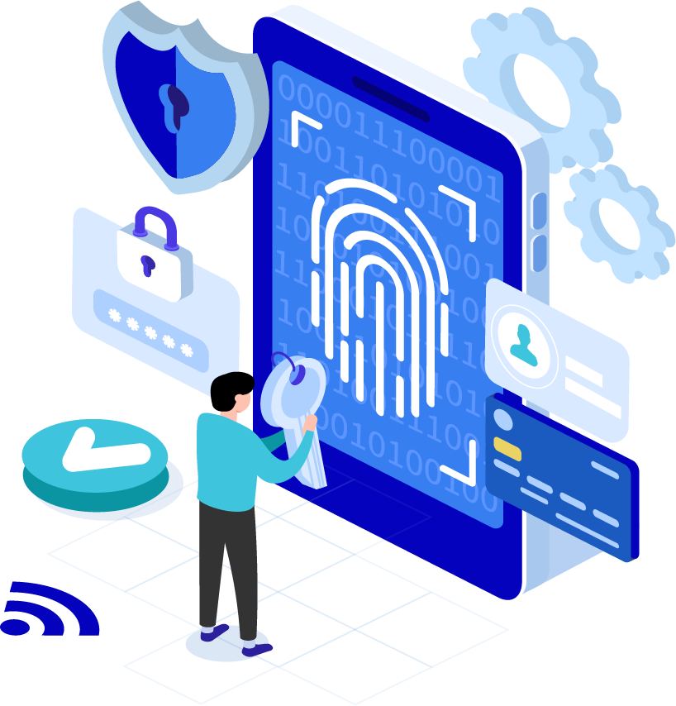
HIPAA Security Rule
A great deal of PHI is stored electronically and/or transmitted by electronic systems. The HIPAA Security Rule was created to specifically address electronic PHI (ePHI).

Slide 43
User Credentials
Only log on to computer systems with your own user ID and password. Never use someone else’s.
You will be held responsible for all activity under your user ID.
Do not share passwords, ID badges, or other access credentials with anyone.
Password complexity is an important deterrent to unauthorized access.

Slide 44
Work E-mail Accounts
DO NOT USE YOUR WORK EMAIL FOR PERSONAL BUSINESS
KDHS provides every employee with an email address. Just because it has your name on it, doesn’t mean it’s yours.
It’s tempting to start using this convenient new address everywhere, however, corporate email accounts are easy targets for spam and viruses.

Slide 45
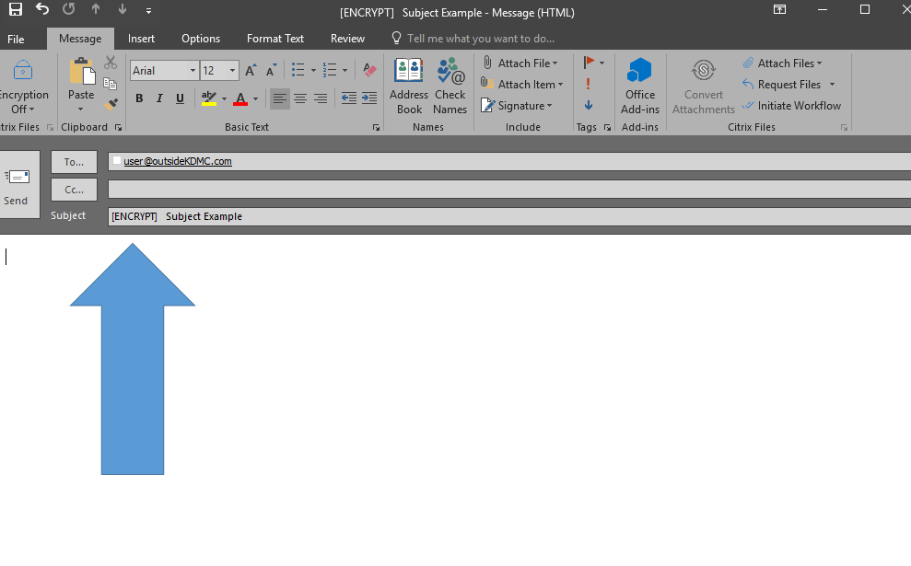
Email Security and Protection
Do not send confidential information in an email, in either the message or in an
attachment, unless the communication line is secure and encrypted.
If you do not know the sender of an email do not open the email, if you inadvertently open the email please do not open attachments or select any hyperlinks.

Slide 46
What can you do?
To avoid these phishing schemes, please observe the following email best practices:
Do not click on links or attachments from senders that you do not recognize. Be especially wary of .zip or other compressed or executable file types.
Do not provide sensitive personal information (like usernames and passwords) over email.
Do not try to open any shared document that you’re not expecting to receive.
Be especially cautious when opening attachments or clicking links if you receive an email containing a warning banner indicating that it originated from an external source. If an email is from an @kdmc.net or @kdmc.kdhs.us email address and it has this warning banner indicating it is a phishing email attempt that has spoofed our email domain:
***This is an email from an External Source – DO NOT click on unsolicited links or attachments
from an unknown sender. Never provide your User ID or Password***

Slide 47
Location, Access, and Media Protection
Keep your KDMC badge with you or in a secure location at all times. KDMC badges allow access to a variety of locations and should always be protected.
Do not “prop” doors open or leave windows unlocked. This allows un-secured access.
Keep all file cabinets and drawers locked that contain PHI when you are not present. Remember to keep the keys in a secure location.
Never leave computers unlocked or unattended.
All storage media such as CD’s, DVD’s, and memory sticks must be kept in secure locations.
If any mobile, electronic device, or storage media is lost or stolen, report immediately.

Slide 48
Protecting Patient Information
As a KDMC Team Member, maintaining a patient's privacy is part of your job. You should access or view a person's PHI only when it is required for your job. Simply because you are able to see a person's PHI does not mean it is legal.
KDMC routinely conducts audits of access to patient records and our systems to ensure proper access by Team Members
All of our patients are entitled to privacy and confidentiality.
Do your part and only look at information you need to do your job.

Slide 49

DO NOT:
Do not look up the medical records of co-workers, friends, family members, neighbors, or celebrities unless it is required by your job.
Do not look up your own medical record. this is a violation of KDMC procedures. There are approved methods to retrieve your PHI.
Snooping in a person’s PHI can lead to disciplinary action up to and including termination.

Slide 50
Examples of Inappropriate Access
Accessing records to “check on a patient” because you saw a news story about the patient and wanted to see their status
Accessing the records of a family member when you are not involved in their care
Accessing medical records of a neighbor out of curiosity
Accessing medical records of a co-worker in the hospital to “see how they are doing”
Accessing your child’s or spouse’s medical records to check their health status
Obtaining telephone numbers or demographic information without proper authorization
or necessary means

Slide 51
Social Media and Patient Privacy
NEVER share identifiable information about patients on social media, for example:
  Posting of patient name/date of birth
  Posting of images and videos of patients without written consent
  Posting of gossip about patients
  Posting of any information that could allow an individual to be identified
  Sharing of photographs or images taken inside a healthcare facility in which patients or PHI are visible
  Sharing of photos, videos, or text on social media platforms within a private group
Identifiable information can also include tattoos, birthmarks, moles, patient’s face or initials
Considered by Privacy Department to be a high risk activity
Corrective action can include termination
“HIPAA Social Media Rules”. HIPAA Journal. April 2022. www.hipaajournal.com/hipaa-social-media

Slide 52

THINK before you speak, post online or hit send
Take into consideration:
  Who might be able to read this?
  Am I posting in anger?
  Could someone feel disrespected?
  Does my post include information to identify the individual?
  Am I revealing too much about myself?
  Am I showing a bad side of myself?
  Could someone misinterpret what I’m saying?

Slide 53
Contact Information
David McDonald, Information Security Officer, ext. 89139.
Heather Marcum, Compliance & Privacy Officer, ext. 80161.

Slide 54
Additional Resources
All KDMC Compliance, Privacy and Security Policies are located on the Intranet for Team Member education, reference and guidance.

