Slide 1
General Compliance Training
FY2020

Slide 2
King’s Daughters Commitment
King’s Daughters is committed to compliance with applicable laws, rules and regulations, including the Anti-Kickback Statute, Stark Law, and other federal healthcare laws and regulations.
At the direction of the Board of Directors, King’s Daughters established a comprehensive compliance program through the establishment of the Compliance & Integrity Department.
The Compliance & Integrity Program (“Program”) aligns with the Office of Inspector General (OIG) Guidelines and the Federal Sentencing Guidelines. The Program contains the following seven elements: (i) written policies, procedures and Code of Conduct; (ii) compliance officer and compliance committee; (iii) training and education; (iv) effective lines of communication for reporting concerns; (v) enforcement and discipline of policies and procedures; (vi) internal monitoring and auditing program; and (vii) response and prevention program to detect, deter and prevent offenses and violations of fraud, waste and abuse.

Slide 3
Seven Elements of the OIG Model Compliance Program
Policies and Procedures
Compliance Officer and Compliance Oversight
Screening Employees, Contractors, Physicians, Board Members
Education
Auditing and Monitoring
Corrective Actions to Identified Problems
Enforcement of Violations

Slide 4
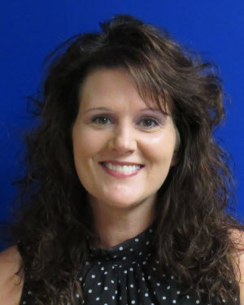
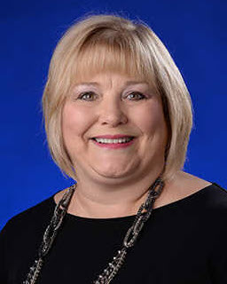
Corporate Compliance & Integrity Team
Heather Marcum
Ext. 80161
Mona Thompson
Ext. 84496

Slide 5
How do I report suspected compliance violations?
All King’s Daughters team members, providers, and contractors/vendors are required to report concerns about actual, potential or perceived misconduct to the Compliance & Integrity Department. One may use any of the following reporting tools:
Call the Compliance Hotline at (606) 408-4145 or (877) 327-4145;
Call the Lighthouse Services Hotline at (844) 940-0003 which is an independent third-party hotline provider contracted by the Health System as an additional anonymous reporting tool;
Complete the Compliance Concern Form found on the intranet;
Contact Vice President/Chief Compliance Officer, Mona Thompson @ (606) 408-4496;
Contact Compliance Officer, Heather Marcum @ (606) 408-0161;
Contact your supervisor, director or Vice President;
Email corporatecompliance@kdmc.kdhs.us (not anonymous);
Send written correspondence intercompany to 2201 Lexington Avenue, Ashland, KY 41101 Attn: Compliance & Integrity Department.

Slide 6
Inducements to Patients
Social Security Act – enacted as part of the Health Insurance and Accountability Act of 1996 (HIPAA), prohibits providers of Medicare or Medicaid payable services from offering remuneration to beneficiaries.
Examples of remuneration are:
Waivers of copayments and deductible amounts
Providing items or services for free or for other than fair market value
Providing gifts of more than nominal value
King’s Daughters has a financial assistance policy which defines the process and procedures for patients without the means to pay for services to obtain assistance. Applications for financial assistance may be obtained:
Health System’s website at www.kingsdaughtershealth.com;
E-mailing the Financial Resource Center (FRC) team at FinancialAssistanceTeam@kdmc.kdhs.us;
Calling the FRC team at (606)408-4118 or (866)408-6466;
Sending a fax to (606)408-6917; or
Mailing a request to the FRC team at:
King’s Daughters Health System
Attn: Financial Resource Center
P.O. Box 151
Ashland, KY 41105
Anyone contacting the Health System’s FRC may request applications be mailed, faxed, or e-mailed to them.

Slide 7
Inducements to Patients
So how does this apply to team member’s everyday work:
Neither KDHS nor team members are permitted to give cash, either individually or collectively, to patients or families
Social work team can access resources to assist patients in some circumstances
As part of service recovery, and occasionally through grant funding, KDHS provides small amenities and/or gas cards to patients/families
Gifts to patients/families are limited to a retail value of no more than $15 individually, and no more than $75 annually per patient
Patient representative team tracks items provided to patients and families

Slide 8
Federal False Claims Act
The False Claims Act (FCA) is a federal law that imposes liability on persons and companies who make false claims for payment to the federal government.
The Health System’s Compliance Program Policy A1, Preventing, Detecting, and Reporting Fraud, Waste and Abuse, reiterates the Health System’s commitment to preventing, detecting, reporting and correcting fraud, waste and abuse.
When physicians, hospitals and other health care providers submit claims to government health care programs these important certifications are made:
the services were medically necessary
were actually performed, and
were performed in accordance with all applicable rules and regulations.

Slide 9
Fraud, Waste and Abuse
King’s Daughters is committed to preventing, detecting, reporting and correcting fraud, waste and abuse
Examples of fraud, waste and abuse can include:
Misrepresentation of the type or level of service provided;
Misrepresentation of the individual rendering service;
Billing for items and services that have not been rendered;
Billing for services that have not been properly and timely documented;
Billing for items and services that are not medically necessary;
Seeking payment or reimbursement for services rendered for procedures that are integral to other procedures performed on the same date of service (unbundling);
Seeking increased payment or reimbursement for services that are correctly billed at a lower rate (up-coding)
Misusing codes on a claim; and
Charging excessively for services or supplies.

Slide 10
How does the Health System prevent violations of the False Claims Act?
At the direction of the Board of Directors, King’s Daughters established a comprehensive compliance program through the establishment of the Compliance & Integrity Department.
Here are some examples of compliance program activities:
Internal Audit’s auditing efforts;
Compliance & Integrity Department’s monitoring and auditing compliance plan;
Contracting with external resources to provide reviews;
Revenue Cycle’s data mining and monitoring;
Leaders’ self-monitoring their department risks;
Annual Compliance Risk Assessment;
Review of the Office of Inspector (OIG) Work Plan which identifies risks;
Follow up on concerns reported to the Compliance & Integrity Department

Slide 11
The Affordable Care Act requires that a person (e.g., provider, hospital, medical office) who received a Medicare or Medicaid Overpayment to report and return the Overpayment.
What is an Overpayment? A Medicare or Medicaid overpayment is “any funds that a person receives or retains to which the person, after applicable reconciliation, is not entitled.”
Examples of Overpayments include, but are not limited to, the following:
Billing the wrong level of care for an office visit;
Separately billing services which should have been bundled into one bill;
Billing for an MRI when a CT was performed;
Billing for a service which was not properly documented; or
Billing for a service which was not medically necessary.
It doesn’t matter if an Overpayment is a mistake or not intentional. If Medicare or Medicaid paid an excess amount, an Overpayment occurred.
Overpayments

Slide 12
Medical Necessity
Medical Necessity is a term which can be complex for all stakeholders in healthcare.
A provider’s understanding of medical necessity may be different from that of a patient, patient’s family or third-party payer. Different stakeholders sometimes apply the term in different ways.
CMS gives a definition of Medical Necessity in the Social Security Act:
“…no Medicare payment shall be made for items or services that are not reasonable and necessary for the diagnosis or treatment of illness or injury or to improve the functioning of a malformed body member”
Because the diagnosis drives the determination of medical necessity, it is important the patient’s history and assessment to be thoroughly documented in the medical record.
Medicare issues National Coverage Determinations (NCDs) and Local Coverage Determinations (LCDs) to provide guidance on coverage requirements/limitations for specific treatments or procedures. NCDs and LCDs are available on the internet.
Adding to medical necessity complexity are third-party payers who often have specific coverage rules for specific treatments or procedures. If you have questions regarding medical necessity, please contact leaders in your work area or the Compliance and Integrity team.

Slide 13
Overpayments
An Overpayment must be reported and returned no later than sixty (60) days after the date on which the Overpayment was identified.
Failure to report an Overpayment may result in liability under the False Claims Act.
If you suspect an Overpayment has occurred, immediately contact your supervisor or the Compliance & Integrity Department.

Slide 14
Preventing Overpayments
To reduce the chance that an overpayment could be made, King’s Daughters takes these actions:
Monitoring. Billing functions for professional, hospital, and home care services are regularly monitored by applicable departments;
National and Local Coverage Determinations. National and Local Coverage Determinations identify Medicare’s payment and coverage criteria for certain tests and procedures. Many of these National and Local Coverage Determinations are ‘built’ in EPIC and generate prompts when entering a test or procedure;
Audits. Audits are performed by Internal Audit, Compliance & Integrity, and external contractors.
Reporting. Team members are required to report any suspected concern with billing activities which may result in overpayment. Reports can be made using any of the available reporting methods.

Slide 15
National and Local Coverage Determinations
One way Medicare provides guidance regarding medical necessity is through the issuance of National (federal) Coverage Determinations and Local (regional) Coverage Determinations (NCD/LCD) (see Administrative Policy A(7))
NCD/LCD document identifies the conditions under which payment will be made for certain tests, services and procedures.
Department directors are responsible to be knowledgeable of those NCD/LCDs which pertain to the services provided by the Department and ensure the NCD/LCD elements, as applicable, are met
Elective ordered tests, services and procedures which do not meet NCD/LCD requirements should be processed in accordance with Administrative Policy A(5), Issuance of Advance Beneficiary Notice

Slide 16
EMTALA
Emergency Medical Treatment and Active Labor Act (EMTALA)
EMTALA is a federal law designed to assure access to emergency services regardless of ability to pay.
When a patient presents to the ED, a provider must conduct a medical screening examination for an emergency medical condition, including active labor, regardless of the individual’s ability to pay.
Hospitals are required to provide stabilizing treatment for patients with emergency medical conditions. If they are unable to stabilize patient within its capability, or if the patient requests, an appropriate transfer should be implemented.

Slide 17
HIPAA and IT Security

Slide 18
Notice of Privacy Practice
HIPAA requires King’s Daughters to provide each patient a “Notice of Privacy Practice” which:
Describes how the facility may use and disclose PHI
Advises the patient of his/her privacy rights
King’s Daughters must attempt to obtain a patient’s signature acknowledging receipt of the Notice, EXCEPT in emergency situations. If a signature is not obtained, the reason must be documented.
The registration process is critical in distributing the Notice of Privacy Practices and getting patient signatures.

Slide 19
Business Associates
HIPAA also applies to business associates. A business associate is any person or organization who provides services to King’s Daughters which involves use or disclosure of PHI.
Examples: Billing vendors, Tri-Data, Maintenance service providers, etc.
To comply with HIPAA, all business associates must have business associate agreements with King’s Daughters.
King’s Daughters can be held responsible if our business associates are not compliant with HIPAA.
If you utilize a vendor who may qualify as a business associate, please contact Legal Services to assure an appropriate agreement is in place.

Slide 20
Protecting Patient Information
As a King’s Daughters Team Member, maintaining a patient's privacy is part of your job. You should access or view a person's PHI only when it is required for your job. Simply because you are able to see a person's PHI does not mean it is permissible.
King’s Daughters routinely conducts audits of access to patient records and our systems to ensure proper access by Team Members
All patients are entitled to privacy and confidentiality. Do your part and only look at the Minimum Necessary information you need to do your job.

Slide 21
Protected Health Information
Protected Health Information (PHI) is information you create or receive in the course of providing treatment or obtaining payment for services. It includes:
Information related to the past, present or future physical and/or mental health or condition of an individual; the provision of healthcare to an individual; or the past, present or future payment for the provision of healthcare; AND
Includes at least one of the 18 personal identifiers OR there is a reasonable basis to believe the information can be used to identify the individual.
Information in all formats – oral, written, electronic – including videos, photographs, x-rays, etc. - must be protected
It DOES NOT include health information about individuals who have been deceased more than 50 years.

Slide 22
PHI Identifiers
The 18 identifiers are:
Name
Postal Address
All elements of dates except year
Telephone number
Fax number
Email address
URL address
IP address
Social Security Number
Account Numbers
License numbers
Medical record number
Health plan beneficiary number
Device identifiers & their serial numbers
Vehicle identifiers and serial number
Biometric identifiers
Full face photos & other similar images
Any other unique identifying number, code or, characteristic

Slide 23
How Can PHI Be Used?
Providers are permitted to use or disclose PHI for:
Treatment
Payment
Healthcare operations (e.g., legal, medical staff/peer review, audit, business management)
The individual patient who is the subject of the PHI, and
Other uses and disclosures required by law
In all other instances, a written authorization from the patient is needed.
Whenever in doubt about release of information, contact Medical Records Department, Privacy officer, or Legal Services for guidance.

Slide 24
Privacy Tips
Never take unsecured PHI home with you
Speak quietly in work areas
Avoid using patient names or discussing cases in public areas
We live in a small community, and even the smallest details might be identifiable to someone who overhears.
Use the shred bins located throughout King’s Daughters to shred documents (that do not need to be preserved) with PHI
Always obtain at least two patient identifiers before handoff of documents or discussing patient information

Slide 25
Do not look up the medical records of co-workers, friends, family members, neighbors, or celebrities unless it is required by your job.
Do not look up your own medical record. Doing so is a violation of KD policy. You can access your own record via My Chart or by making a request to the Medical Records Dept
Be aware - Snooping on PHI can lead to disciplinary action up to and including termination.

Slide 26
Common Breaches
Here are some examples of common unauthorized uses and disclosures of PHI that must be reported to the Privacy Officer:
Fax sent to wrong number
Patient statements or discharge papers given to wrong patient
Envelopes not sealed or having the wrong mailed label affixed
Unencrypted mobile devices or storage media
Unauthorized patient pictures or information posted on social media websites
Disposing of patient information incorrectly
Accessing patient information that is not job-related
Giving information and not obtaining information at registration process

Slide 27
Why Report Privacy Concerns?
King’s Daughters is required by law to report breaches to the Department of Health and Human Services, Office of Civil Rights.
When King’s Daughters reports a breach, we are essentially reporting a violation of the Privacy Rule (HIPAA).
If HHS suspects that the breach or violation resulted from “willful neglect,” they will conduct a compliance review.
A fine of up to $50,000 per violation can be assigned for each HIPAA violation

Slide 28
User Credentials
Only log on to computer systems with your own user ID and password. Never use someone else’s.
You will be held responsible for all activity under your user ID
Log off from work stations when you walk away from it
Do not share passwords, ID badges, or other access credentials with anyone.
Password complexity is an important deterrent to unauthorized access.

Slide 29
Work E-mail Accounts
DO NOT USE YOUR WORK EMAIL FOR PERSONAL BUSINESS
KDHS provides every employee with an email address. Just because it has your name on it, doesn’t mean it’s for your personal use.
You may be tempted to use this convenient new address everywhere. However, corporate email accounts are easy targets for spam and viruses.

Slide 30
Email Security and Protection
Do not send confidential information in an email, in either the message or in an attachment, unless the communication line is secure and encrypted.
If you do not know the sender of an email do not open the email, if you inadvertently open the email do not open attachments or select any hyperlinks.
[Encrypt]

Slide 31
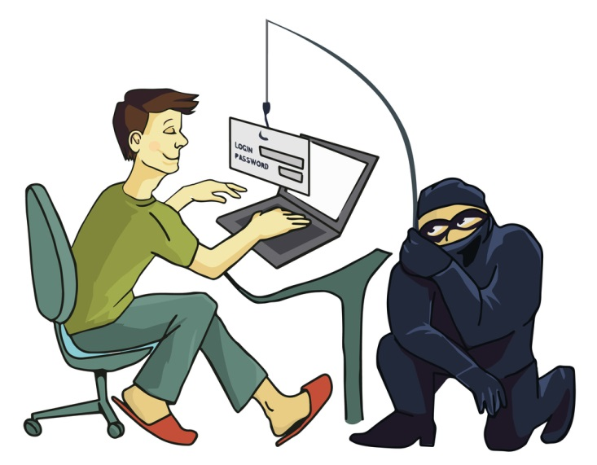
Phishing
In this type of attack, hackers impersonate a real company to obtain your login credentials.
You may receive an e-mail asking you to verify your account details with a link that takes you to an imposter login screen which delivers our information directly to the attackers.

Slide 32
What can you do?
To avoid these phishing schemes, observe the following email best practices:
Do not click on links or attachments from senders you do not recognize. Be especially wary of .zip or other compressed or executable file types.
Do not provide sensitive personal information (like usernames and passwords) over email.
Do not open any shared document that you’re not expecting to receive.
Be especially cautious when opening attachments or clicking links if you receive an email containing a warning banner indicating that it originated from an external source. If an email is from an @kdmc.net or @kdmc.kdhs.us email address and it has the warning banner below, this is an indication of a phishing email attempt that has spoofed our email domain:
***This is an email from an External Source – DO NOT click on unsolicited links or attachments from an unknown sender. Never provide your User ID or Password***

Slide 33
The Impact of Social Media

Slide 34
The Good Healthcare Social Media
Communicating with customers and patients quickly and inexpensively
Promoting wellness programs
Provide health education
Marketing new services
Announcing the latest achievements
Communicating mission and vision
Recruitment

Slide 35
The Bad Healthcare Social Media
Inability to screen for inappropriate content
Risks are internal (employees, medical staff, contractors, or volunteers)
Potential for violation of patient’s privacy

Slide 36
Social Media: Never share PHI on any form of social media (Facebook, YouTube, Instagram, Twitter, Snapchat, Marco Polo, or others). Remember photos are a patient identifier!
News Media: Never share PHI with any member of the news media. All media requests must be referred to team members who are authorized to speak on behalf of the organization. For King’s Daughters this is our marketing department team – Tom Dearing or Elaine Corbitt – or their designee.

Slide 37
Code of Conduct
Guide which supports day-to-day decision making with KDHS's standards of professional conduct
Essential element of KDHS's Compliance & Integrity Program
A commitment by each team member, provider, vendor, contractor, board member, and volunteers
Identifies KDHS’s mission, values and principles with standards of professional behavior and ethics

Slide 38
Code of Conduct
King’s Daughters Health System is committed to honest and ethical behavior and to conducting our business with integrity. The practice of behaving honestly, ethically and with integrity is an individual responsibility. We make decisions about how to conduct ourselves every day as we go about our work. Each of us is accountable for the actions that we choose to take.
The Health System’s Code of Conduct is the keystone of its corporate integrity philosophy and communicates its ethical business standards. The Code of Conduct serves as a cultural compass for team members, management, vendors/contractors, volunteers and others who interact with the Health System. It is an essential element of our Compliance & Integrity Program.
The Compliance & Integrity Department oversees the Health System’s Compliance & Integrity Program and ensures the Health System maintains its commitment to conducting our business with integrity. The Compliance & Integrity Program is a partnership among all of us to make the right business choices.

Slide 39
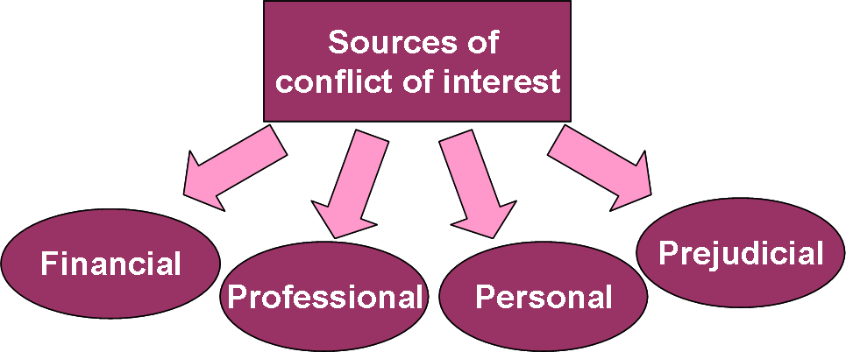
Team members are asked to report potential conflicts of interest:
Upon hiring / on boarding process
Any time a conflict develops (don’t wait until each year’s annual training)
During annual compliance training
TM may not use their positions to profit personally at the expense of the Health System.
Examples of Potential Conflicts:
Provide consulting services to competitor
Responsible for purchasing medical devices and you own a medical device company
Directly supervising a close family member or in a position to make decisions to benefit the family member

Slide 40
Gifts and Gratuities
King’s Daughters Code of Conduct identifies:
Team members may accept unsolicited business courtesies from vendors, excluding cash, up to $50.00 (For this reason, we are most often unable to accept vendor offers for complimentary conference attendance).
Team members and contracted providers may accept an unsolicited gift, excluding cash, from a patient or a patient’s family member of less than $100.00.
NOTE: Mastercard and/or Visa gift cards are considered cash.
Examples of acceptable gifts are:
$25.00 gift cards for Starbucks, Texas Roadhouse, Cheddars
$50.00 Cinemark movie pass
Flower arrangement, candle
Edible Arrangements bouquet, a cake from Tipton’s or cookies from Sweet Caroline’s

Slide 41
Gifts to Medical Staff and/or Immediate Family
Non-monetary compensation to physicians and their immediate family is regulated by CMS
Examples of non-monetary compensation are: non-working meals, gift baskets, physician appreciation events, holiday parties, sporting events
Medical Staff Office tracks non-monetary compensation to physicians
$416 annual limit this year
Please report any gift to a provider or provider family member to Medical Staff Office

Slide 42
Workplace / Sexual Harassment policy J(4)
King’s Daughters strives to maintain a workplace that fosters mutual team member’s respect and promotes harmonious, productive working relationships. In providing a productive working environment, King’s Daughters believes that its team members should be able to enjoy a workplace free from all forms of discrimination, including harassment on the basis of race, color, religion, gender, national origin, age, disability, veteran status, uniformed service, marital status, pregnancy, sexual orientation, gender identity, or any other status or characteristic protected by law.
It is King’s Daughters policy to provide an environment free from such harassment.
It is a violation of policy for any team member, whether a manager, supervisor or co-worker, to harass another team member. Harassment of third parties by King’s Daughters team members, or harassment by third parties of King’s Daughters team members, is also prohibited.

Slide 43
Workplace / Sexual Harassment policy J(4)
Prohibited harassment occurs when verbal or physical conduct that defames or shows hostility toward an individual because of his or her race, color, religion, gender, national origin, age, disability, veteran status, sexual orientation, gender identity, or any status protected by law, or that of the individual’s relatives, friends or associates, which creates or is intended to create an intimidating, hostile or offensive working environment, interferes or is intended to interfere with an individual’s work performance, or otherwise adversely affects an individual’s employment opportunities.
Sexual and other unlawful harassment also includes any acts, statements, or suggestions indicating that a team member’s job security, professional advancement, salary, benefits, work assignment, or other conditions of employment depend on tolerating sexual harassment or that employment will be adversely affected by refusing to condone sexual harassment anywhere in the workplace. It also includes any acts, statements, or suggestions that a team member’s physical attractiveness or perceived lack of physical attractiveness in the eyes of the harasser is a factor in obtaining and securing professional opportunities.

Slide 44
Workplace / Sexual Harassment policy J(4)
*Prohibited conduct may include, but is not limited to:
Epithets, slurs, negative stereotyping or threatening, intimidating or hostile acts which relate to race, color, religion, gender, national origin, age, disability, veteran status, sexual orientation, gender identity, or any other status protected by law;
Written or graphic material that defames or shows hostility or aversion toward an individual or group;
Repeated unwelcome flirtations, advances, or propositions;
Racial Slurs;
Sexually graphic or degrading comments about a team member’s appearance, dress, or anatomy;
Display of graphic, sexually suggestive objects or pictures;
Repeated unwelcome dirty jokes or offensive gestures;
Graphic descriptions of one’s own sexual experiences;
The unwelcome use of familiarities or diminutives, such as “honey,” “sweetheart,” “darling,” “dear,” or “baby”; this can include referring to adult women as “girls”;
Practical jokes aimed at anyone because of their inclusion in a legally protected class (e.g. race, religion, national origin, ethnicity, gender, etc.);
Leering, whistling, and catcalls;
Unwelcome physical contact: touching, hugging, kissing, patting, pinching, tugging at clothing, etc.;
Physical or sexual assault;
Jokes about physical or mental disabilities/impairments.

Slide 45
Workplace / Sexual Harassment policy J(4)
Your responsibilities:
Any team member who believes that he or she has been unlawfully harassed or discriminated against, and/or any team member who observes unlawful harassment or discrimination of any type, should report the conduct immediately
Upon receiving a report of harassment or discrimination, King’s Daughters will conduct a thorough and impartial investigation and take appropriate action. All team members are expected to cooperate with an investigation of any type of harassment or discrimination and are required to provide truthful and complete information.
Any team member of King’s Daughters who has been found, after appropriate investigation, to have harassed or discriminated against another team member in violation of this policy will be subject to disciplinary action up to and including termination.
No team member will be subjected to any form of reprisal or retaliation for filing a good faith complaint of harassment or discrimination, or otherwise bringing good faith concerns to King’s Daughters attention, or for participating in or cooperating in good faith with an investigation of alleged discrimination or harassment. If, however, after investigating any complaint of harassment or unlawful discrimination, it is determined the complaint was not honest or not made in good faith, or that an team member provided false information regarding the complaint, disciplinary action may be taken against the individual who filed the dishonest or bad faith complaint or who gave the false information.

Slide 46
Intent
Behavior may not be intended as harassment, but it’s the impact and perception of the receiving person, not the intent of the person displaying the conduct, that matters.

Slide 47
Non-Exempt Time and Attendance
Do make sure all of your time is tracked and reported.
Do seek prior approval before working overtime.
Do immediately report to your supervisor if you work outside of your normal working hours, even if without prior permission.
Do ask any question you have.
Do record your time accurately via Quick Badge.
Do not work when you are clocked-out, before or after your scheduled shift, or at home.
Do not work during your meal periods.
Do not take work-related calls, texts or emails after work hours.
Do not ask someone else to clock you in or out or give your user name and password to another person.

Slide 48
Abuse
Abuse, neglect, exploitation know no boundaries. Any patient, at any age can become a victim, although people who depend on others for their emotional and physical health are at high risk.
Everyone has a responsibility to immediately report suspected cases of abuse, neglect, domestic violence, sexual assault, or exploitation to Social Services.
Social worker is on call 24/7 and can be reached through the switch board operator.

Slide 49
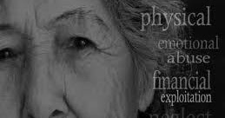
Elder Justice Act
The Elder Justice Act was enacted in March of 2010 to protect the elderly from abuse, exploitation and neglect. The Act requires certain residential care facilities to notify staff of the Elder Justice Act reporting requirements. Under these requirements, suspected abuse, exploitation, and neglect of elderly residents in a care facility must be reported in a very short time period.
Team members of TCU and Kingsbrook will receive additional training on these reporting requirements.

Slide 50
Government or Accrediting Agency Contact
If an agency requests information or access, in writing or in person, notify Compliance or Risk Management
If an agency arrives at any location, notify Quality or Accreditation
Always obtain Legal Services review PRIOR to signing any document on behalf of King’s Daughters

Slide 51
Government or Accrediting Agency Contact
Administrative policy G(1) defines Purchasing and Expenditure Authority Limits
The Director of Material Management is the designated agent of King’s Daughters for purchasing and is authorized to enter into such agreements on behalf of the Health System within the scope of his/her position
Other agreements, contracts, and documents requiring the signature of a King’s Daughters representative must be reviewed by the Legal Services Department before signing
The requirement for review before signing on behalf of the organization applies to any and all requests from government agencies, regulatory bodies, vendors, partners and/or licensing organizations
If you have any questions regarding authorization to sign a document, DO NOT SIGN until your question is answered by Legal Services Department

Slide 52
How do I report suspected compliance violations?
All King’s Daughters team members, providers, and contractors/vendors are required to report concerns about actual, potential or perceived misconduct to the Compliance & Integrity Department. One may use any of the following reporting tools:
Call the Compliance Hotline at (606) 408-4145 or (877) 327-4145;
Call the Lighthouse Services Hotline at (844) 940-0003 which is an independent third-party hotline provider contracted by the Health System as an additional anonymous reporting tool;
Complete the Compliance Concern Form found on the intranet;
Contact Vice President/Chief Compliance Officer, Mona Thompson @ (606) 408-4496;
Contact Compliance Officer, Heather Marcum @ (606) 408-0161;
Contact your supervisor, director or Vice President;
Email corporatecompliance@kdmc.kdhs.us (not anonymous);
Send written correspondence intercompany to 2201 Lexington Avenue, Ashland, KY 41101 Attn: Compliance & Integrity Department.

Slide 53
In Conclusion
Compliance can be summarized in a short phrase…

