Slide 1
Corporate Compliance and Integrity Team
Heather Marcum
x80161

Slide 2
What is a Corporate Compliance Program?
Corporate Compliance refers to the Medical Center’s program to ensure the Medical Center complies with:
(a) Federal, state and local laws;
(b) Federal healthcare program requirements; (c) the Code of Conduct; and
(d) the Medical Center’s policies and procedures.

Slide 3
What is a Corporate Compliance Program?
KDMC’s Compliance Program:
Demonstrates to the community the Medical Center’s commitment to corporate citizenship;
Reinforces the Medical Center’s culture of ethics, integrity accuracy to all team members and provides guidelines for leadership compliance responsibilities;
Provides an expectation of team member, provider and contractor behavior;
Provides procedures to correct misconduct;
Provides effective communications for Board of Directors through an organized framework for regulatory compliance tracking and reporting;
Protects the financial viability of the Medical Center;
Mitigates sanctions which may be imposed by the government;
Ensures the Medical Center provides the highest level of quality care;
Protects the Protected Health Information (PHI) of the patients.

Slide 4
Seven Elements of the OIG Model Compliance Program
Policies and Procedures
Compliance Officer and Compliance Oversight
Screening Employees, Contractors, Physicians, Board Members
Education
Auditing and Monitoring
Corrective Actions to Identified Problems
Enforcement of Violations

Slide 5
Compliance & Integrity Committee
It is important you know who the members of the Compliance & Integrity Committee are listed below. They are available to you as a compliance resource.
Mark Beilstein | Shawn Boggs
Mark Detherage, MD | Chris Epling, DO
Richard Ford, MD | Trish Lewis
Scott Hill | Autumn McFann
Sydney Keeton | Sheryl Mahaney
Shelly McGraw-Baier | Sara Marks
Heather Marcum | Stacy Patrick
Heidi Moore
Kristin Price James Neil Josh Childers | Gretchen Cunningham Tonia Hall Curtis Metzler

Slide 6
Code of Conduct
The Medical Center’s Code of Conduct provides the principle guidelines to conduct daily business activities ethically and legally.
The Code of Conduct is the “Constitution” of the Medical Center’s Compliance & Integrity program and is designed to assure the Medical Center meet compliance goals.
Each of us has a role to play and can make a real difference. We have individual responsibility and accountability to follow the Medical Center policies and procedures, Code of Conduct, Federal health care program requirements, and to conduct activities in an ethical manner.
The Compliance Handbook contains the Medical Center’s Code of Conduct. Review the Code of Conduct and ask questionsif you do not understand what is expected of you.

Slide 7
Code of Conduct
The Code of Conduct must be observed by everyone:
Team Members;
Leadership Team;
Board of Directors;
Medical Staff and Allied Health Professionals;
Vendors and Contractors;
Students; and
Volunteers

Slide 8
Conflicts of Interest
A Conflict of Interest arises in the workplace when a team member has competing interests or loyalties that either are, or potentially can be, at odds with each other.
The Medical Center expects its Team Members, Medical Staff Members, Volunteers and Contractors and Vendors to exercise attention, good judgment and prudence in their relationships, obligations and financial interests so that they do not conflict with the interests of the Medical Center or the performance of their duties.
Review the Medical Center’s policy and procedure on Conflicts of Interest.

Slide 9
Fraud, Waste & Abuse
Healthcare is a government enforcement priority because of the potential for fraud, waste and abuse.
Fraud is making material false statements or representations of facts that an individual knows to be false or does not believe to be true in order to obtain payment or other benefit to which we would otherwise not be entitled
Abuse are practices that directly or indirectly result in unnecessary costs or improper payments for services which fail to meet recognized professional standards of care
Waste is overutilization of services or other practices that, directly or indirectly, result in unnecessary costs to the health care system, including the Medicare and Medicaid programs.
The Federal False Claims Act governs violations of Federal health care program requirements.

Slide 10
Fraud, Waste & Abuse
King’s Daughters is committed to preventing, detecting, and correcting fraud, waste, and abuse within our operations
All team members have an obligation to report possible compliance violations to the Compliance & Integrity Department.
Team members also have the ability to report possible violations of the False Claims Act (FCA) directly to the Federal Department of Justice as a qui tam (also known as whistleblower) relator.

Slide 11
How do I report suspected compliance violations?
All Medical Center team members, providers, and contractors/vendors are required to report concerns about actual, potential or perceived misconduct to the Compliance & Integrity Department. One may use any of the following reporting tools:
Call the Compliance Hotline at (606) 408-4145 or (877) 327-4145;
Call the Lighthouse Services Hotline at (844) 940-0003 which is an independent third-party hotline provider contracted by the Medical Center as an additional anonymous reporting tool;
Complete the Compliance Concern Form found on the intranet;
Contact Compliance Officer, Heather Marcum (606-408-0161);
Contact your supervisor, director or Vice President;
Email corporatecompliance@kdmc.kdhs.us (not anonymous);
Send written correspondence intercompany to 2201 Lexington Avenue, Ashland, KY 41101 Attn: Compliance & Integrity Department.

Slide 12
What kinds of things should I report?
Violations of the law (Federal, state or local)
Violations of the Federal healthcare program requirements
Inappropriate gifts, entertainment or gratuities
Discrimination
Workplace or sexual harassment
Hostile work environment, bullying
Stealing/misused of Medical Center’s assets
Billing or coding concerns
Documentation issues
Violations of patient confidentiality (can be reported to Scott Hill and/or Heather Marcum)
Violations of the Code of Conduct
Violations of policies and procedures
Potential conflicts of interest

Slide 13
Inducements
The OIG has interpreted the prohibition on inducements to permit Medicare or Medicaid providers to offer beneficiaries inexpensive gifts (other than cash or cash equivalents) or services without violating the statute.
For enforcement purposes, inexpensive gifts or services are those that have a retail value of no more than $15 individually, and no more than $75 in the aggregate annually per patient.

Slide 14
Guidelines for Gifts and Gratuities
Team members and contracted employees are prohibited from soliciting tips, personal gratuities or gifts from patients or vendors
Team members may accept unsolicited business courtesies from vendors, excluding cash, up to a value of $50.00
Any business courtesy from a vendor in excess of $50.00 in value must be approved by Compliance and Integrity Department in advance of team member acceptance
Team members and contracted providers may accept an unsolicited gift from a patient or a patient’s family member of nominal value (i.e, having a value of less than $100.00)

Slide 15
Disruptive Behavior, Workplace Harassment and Sexual Harassment

Slide 16
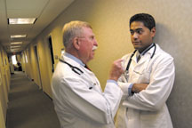
Disruptive Behavior
Inappropriate behavior which interferes with the functioning and flow of the workplace
It hinders or prevents team members, providers and others within the organization from carrying out their workplace responsibilities

Slide 17
Harassment
Unwelcome conduct based on race, color, religion, sex, national origin, age, disability or genetic information
Harassment becomes unlawful where the conduct is severe or pervasive enough to create a work environment that a reasonable person would consider intimidating, hostile, abusive, or offensive

Slide 18
Sexual Harassment
Sexual harassment is defined as unwelcome sexual advances, requests for sexual favors or other verbal or physical conduct of a sexual nature when:
Submission to such conduct is made either explicitly as a term or condition of one’s employment;
After submission to or rejection of such conduct by the individual imposed upon it used as the basis for employment decisions;
Such conduct has the purpose or effect of unreasonably interfering with one’s work performance or creating an intimidating, hostile or offensive working environment.

Slide 19
Intent
It may not be intended to be harassment, but it’s the impact and perception of the person listening, not the intent of the person speaking, that matters.

Slide 20
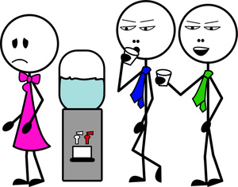
Examples of Inappropriate Behavior
Offensive jokes, slurs
Name calling
Physical assaults or threats
Intimidation
Insults or put-downs
Inability to control feelings, outbursts of anger, swearing, slamming doors, etc.
Displaying offensive language, objects or pictures
Bullying, yelling, screaming
Presenting sexually suggestive items

Slide 21
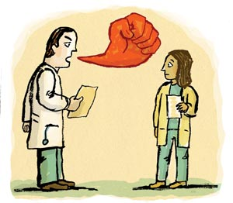
Examples of Inappropriate Behavior
Criticizing co-workers in front of patients or other staff
Unwanted physical touching, poking, pinching, rubbing or hugging
Purposely brushing against a person’s body
Comments about a person’s body or sexual orientation
Sending unwanted suggestive letters, texts, notes, or e-mails
Staring at someone’s body
Throwing charts or instruments

Slide 22
Medical Center Policies Governing
Disruptive Behavior, Workplace Harassment and Sexual Harassment
Code of Conduct
Sexual Harassment (Administrative Policy §J(4))

Slide 23
Responsibilities and Rights
Right to harassment-free workplace
Responsibility to treat all team members, suppliers, contractors, patients, and providers with respect
Responsibility to speak up when harassment and inappropriate behavior occurs
Responsibility to immediately report harassment and inappropriate behavior

Slide 24
Reporting Inappropriate Behavior
Supervisor, manager, director
Human Resources
Risk manager
Vice President
Compliance Officer, Heather Marcum
corporatecompliance@kdmc.kdhs.us
Compliance Concern Form
Lighthouse Services Hotline at (844) 940-0003
Anonymous Compliance Hotline
606-408-4145 or
877-327-4145

Slide 25
Non Retaliation
You have a duty to promptly report actual or potential wrongdoing or inappropriate behavior
Retaliation against any one who, in good faith reports, is strictly forbidden

Slide 27
PRIVACY & SECURITY TRAINING

Slide 28
HIPAA
Health Insurance Portability and Accountability Act (HIPAA) imposes restrictions on the use and disclosure of all protected health information (“PHI”). It requires King’s Daughters to:
Protect the privacy of patient health information
Secure patient health information
Use and disclose patient health information the minimum necessary

Slide 29
Protected Health Information
Protected Health Information (PHI) is information you create or receive in the course of providing treatment or obtaining payment for services. It includes:
Information related to the past, present or future physical and/or mental health or condition of an individual; the provision of healthcare to an individual; or the past, present or future payment for the provision of healthcare; AND
Includes at least one of the 18 personal identifiers OR there is a reasonable basis to believe the information can be used to identify the individual.
In any format – oral, written, electronic – including videos, photographs, x-rays, etc.
It DOES NOT include health information about individuals who have been deceased more than 50 years.

Slide 30
PHI Identifiers
The 18 identifiers are:
Name
Postal Address
All elements of dates except year
Telephone number
Fax number
Email address
URL address
IP address
Social Security Number
Account Numbers
License numbers
Medical record number
Health plan beneficiary number
Device identifiers & their serial numbers
Vehicle identifiers and serial number
Biometric identifiers
Full face photos & other similar images
Any other unique identifying number, code or, characteristic

Slide 31
How Can PHI Be Used?
You are permitted to use or disclose PHI for:
Treatment;
Payment;
Healthcare operations (e.g., legal, medical staff/peer review, audit, business management);
The individual patient who is the subject of the PHI; and
Other uses and disclosures required by law.
In all other instances, a written authorization from the patient is needed.
Whenever in doubt about release of information, contact Medical Records, Privacy officer, or Legal Services for guidance.

Slide 32
Minimum Necessary
As a KDMC team member you should only have access to patient information via computer systems and other sources that you need to do your job.
Accessing patient information which you do not need to as part of your job duties violates policy.

Slide 33
Patient Rights Under HIPAA
Right to access and receive a copy of one’s own PHI (paper or electronic format)
Right to request amendments to information
Right to request restriction of PHI uses and disclosures
Right to restrict disclosure to health plans for services self-paid in full
Right to request alternative forms of communications
Right to an accounting of the disclosures of PHI

Slide 34
Notice of Privacy Practice
The Medical Center must give each patient a “Notice of Privacy Practice” that:
Describes how the Medical Center may use and disclose PHI
Advises the patient of his/her privacy rights
The Medical Center must attempt to obtain a patient’s signature acknowledging receipt of the Notice, EXCEPT in emergency situations. If a signature is not obtained, the Medical Center must document the reason it was not.
The registration process is critical in distributing the Notice of Privacy Practices and getting patient signatures.

Slide 35
MyChart
MyChart is a great way for our team members and patients to stay connected to their care.
Available 24/7
Offers personalized and secure online access
It’s free
Proxy access is available for minor age children or aging adults

Slide 36
What can you do with MyChart?
Ask your provider a question through secure messaging
Review lab and outpatient test results
Save time by doing e-Check in prior to an appointment with your primary care or specialty provider
Self Schedule an appointment (must be an established patient with ….
View list of current medication and request refills
Keep track of upcoming appointments
Access health history, learn more about health conditions, and screening recommendations

Slide 37
Breaches and Reporting
Under the Health Information Technology for Economic and Clinical Health Act (HITECH), when a breach of patient information occurs, the Medical Center has to notify each individual (and the federal government) and let them know their PHI has been compromised.
There are deadlines by which King’s Daughters has to provide notification, so report breaches to the Privacy Officer or Compliance Officer to make sure we meet our deadlines.

Slide 38
Common Breaches
Here are examples of common unauthorized uses and disclosures of PHI that must be reported to the Privacy Officer:
Fax sent to wrong number
Patient statements or discharge papers given to wrong patient
Envelopes not sealed or having the wrong mailed label affixed
Unencrypted mobile devices or storage media
Unauthorized patient pictures or information posted on social media websites
Disposing of patient information incorrectly
Accessing patient information that is not job-related
Giving information and not obtaining information at registration process

Slide 39
Privacy Tips
Never take PHI home with you
Speak quietly
Avoid using patient names in public areas
We live in a small community, and even the smallest details can be identifiable to someone who overhears.
Use the shred bins located throughout King’s Daughters to shred documents (that do not need to be preserved) with PHI
Always obtain at least two patient identifiers before handoff of documents or discussing patient information

Slide 40
HIPAA Security Rule
A great deal of PHI is stored electronically and/or transmitted by electronic systems. The HIPAA Security Rule was created to specifically address electronic PHI (ePHI).

Slide 41
User Credentials
Only log on to computer systems with your own user ID and password. Never use someone else’s.
You will be held responsible for all activity under your user ID.
Do not share passwords, ID badges, or other access credentials with anyone.
Password complexity is an important deterrent to unauthorized access.

Slide 42
Work E-mail Accounts
DO NOT USE YOUR WORK EMAIL FOR PERSONAL BUSINESS
KDHS provides every employee with an email address. Just because it has your name on it, doesn’t mean it’s yours.
It’s tempting to start using this convenient new address everywhere, however, corporate email accounts are easy targets for spam and viruses.

Slide 43
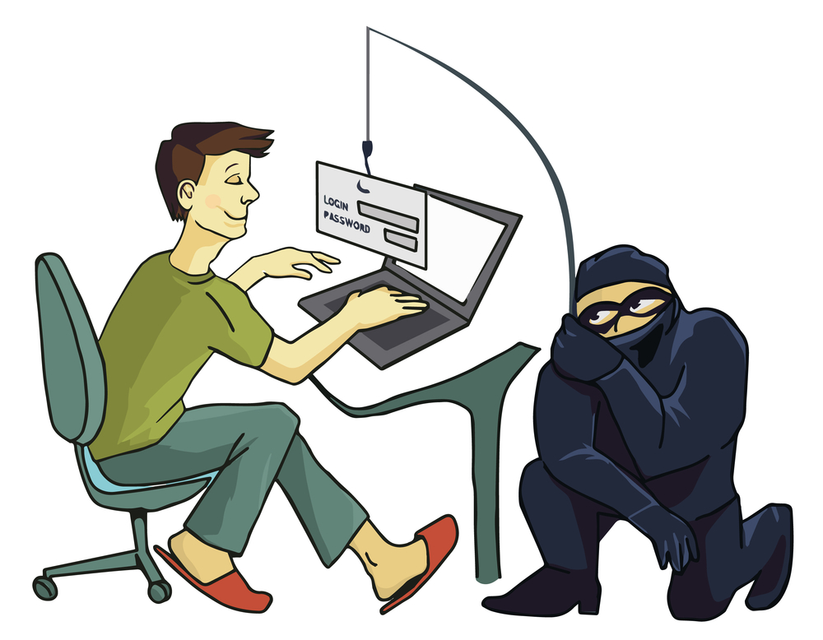
Email Security and Protection
Do not send confidential information in an email, in either the message or in an attachment, unless the communication line is secure and encrypted.
If you do not know the sender of an email do not open the email, if you inadvertently open the email please do not open attachments or select any hyperlinks.
[Encrypt]

Slide 44
What can you do?
To avoid these phishing schemes, please observe the following email best practices:
Do not click on links or attachments from senders that you do not recognize. Be especially wary of .zip or other compressed or executable file types.
Do not provide sensitive personal information (like usernames and passwords) over email.
Do not try to open any shared document that you’re not expecting to receive.
Be especially cautious when opening attachments or clicking links if you receive an email containing a warning banner indicating that it originated from an external source. If an email is from an @kdmc.net or @kdmc.kdhs.us email address and it has this warning banner indicating it is a phishing email attempt that has spoofed our email domain:
***This is an email from an External Source – DO NOT click on unsolicited links or attachments from an unknown sender. Never provide your User ID or Password***

Slide 45
Location, Access, and Media Protection
Keep your KDMC badge with you or in a secure location at all times. KDMC badges allow access to a variety of locations and should always be protected.
Do not “prop” doors open or leave windows unlocked. This allows un-secured access.
Keep all file cabinets and drawers locked that contain PHI when you are not present. Remember to keep the keys in a secure location.
Never leave computers unlocked or unattended
All storage media such as CD’s, DVD’s, and memory sticks must be kept in secure locations
If any mobile, electronic device, or storage media is lost or stolen, report immediately

Slide 46
Protecting Patient Information
As a KDMC Team Member, maintaining a patient's privacy is part of your job. You should access or view a person's PHI only when it is required for your job. Simply because you are able to see a person's PHI does not mean it is legal.
KDMC routinely conducts audits of access to patient records and our systems to ensure proper access by Team Members
All of our patients are entitled to privacy and confidentiality. Do your part and only look at information you need to do your job.

Slide 47
Do not look up the medical records of co-workers, friends, family members, neighbors, or celebrities unless it is required by your job.
Do not look up your own medical record. this is a violation of KDMC procedures. There are approved methods to retrieve your PHI.
Snooping in a person’s PHI can lead to disciplinary action up to and including termination.

Slide 48
Contact Information
David McDonald, Information Security Officer, ext. 89139.
Scott Hill, Chief Privacy Officer for KDMC, ext. 80455.
Heather Marcum, Compliance & Privacy Officer,ext. 80161.

Slide 49
Additional Resources
All KDMC Compliance, Privacy and Security Policies are located on the Intranet for Team Member education, reference and guidance.

