Slide 1
Annual General Compliance Training
2024 - 2025

Slide 2
King’s Daughters Commitment
King’s Daughters is committed to compliance with applicable laws, rules and regulations, including the Anti-Kickback Statute, Stark Law, and other federal healthcare laws and regulations.
At the direction of the Board of Directors, King’s Daughters established a comprehensive compliance program through the establishment of the Compliance & Integrity Department.
The Compliance & Integrity Program (“Program”) aligns with the Office of Inspector General (OIG) Guidelines and the Federal Sentencing Guidelines. The Program contains the following seven elements: (i) written policies, procedures and Code of Conduct; (ii) compliance officer and compliance committee; (iii) training and education; (iv) effective lines of communication for reporting concerns; (v) enforcement and discipline of policies and procedures; (vi) internal monitoring and auditing program; and (vii) response and prevention program to detect, deter and prevent offenses and violations of fraud, waste and abuse.

Slide 3
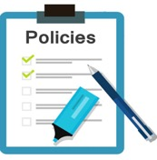






Seven Elements of the OIG Model Compliance Program
Policies and Procedures
Compliance Officer and Compliance Oversight
Screening Employees, Contractors, Physicians, Board Members
Education
Auditing and Monitoring
Corrective Actions to Identified Problems
Enforcement of Violations

Slide 4
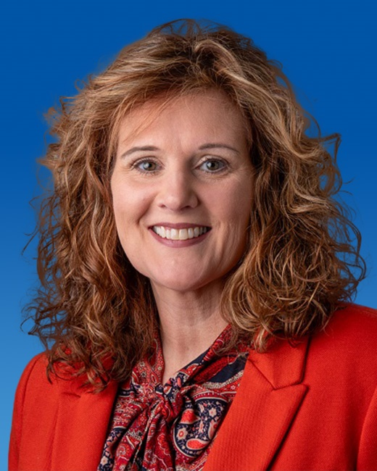
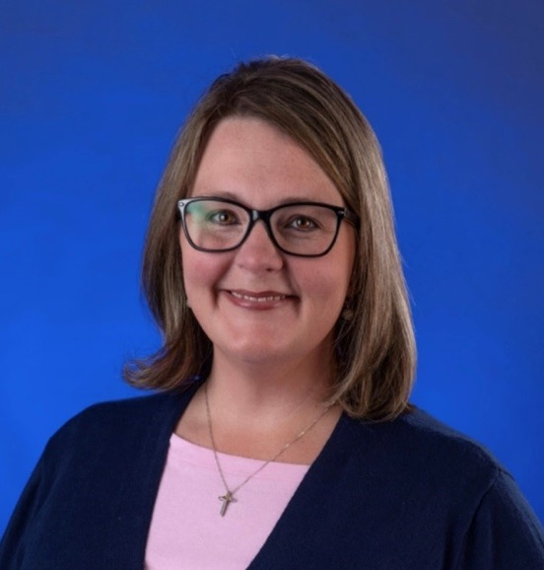
Heather Marcum
Compliance & Privacy Officer
Ext. 80161
Tonia Hall
Compliance & Privacy Manager
Ext. 84451

Slide 5

How do I report suspected compliance violations?
All King’s Daughters team members, providers, and contractors/vendors are required to report concerns about actual, potential or perceived misconduct to the Compliance & Integrity Department. One may use any of the following reporting tools:
Call the Compliance Hotline at (606) 408-4145 or (877) 327-4145;
Call the Lighthouse Services Hotline at (844) 940-0003 which is an independent third-party hotline provider contracted by King’s Daughters as an additional anonymous reporting tool;
Complete the Compliance Concern Form found on the intranet;
Contact Compliance team, Tonia Hall @ (606) 408-4451 or Heather Marcum @ (606) 408-0161
Contact your supervisor, director or Vice President;
Email corporatecompliance@kdmc.kdhs.us (not anonymous);
Send written correspondence intercompany to 2201 Lexington Avenue, Ashland, KY 41101 Attn: Compliance & Integrity Department.

Slide 6

Inducements to Patients
Social Security Act – enacted as part of the Health Insurance Portability and Accountability Act of 1996 (HIPAA), prohibits providers of Medicare or Medicaid payable services from offering remuneration to beneficiaries.
Examples of remuneration are:
  Waivers of copayments and deductible amounts
  Providing items or services for free or for other than fair market value
  Providing gifts of more than nominal value
So how does this apply to team member’s everyday work?
Neither KD nor team members are permitted to give or receive cash, either individually or collectively, to patients or families
Social work team can access resources to assist patients in some circumstances
As part of service recovery, and occasionally through grant funding, KD provides small amenities and/or gas cards to patients/families
Gifts to patients/families are limited to a retail value of no more than $15 individually, and no more than $75 annually per patient
Patient representative team tracks items provided to patients and families
If you perform service recovery to a patient, please make your manager or supervisor aware for tracking purposes

Slide 7

Federal False Claims Act
The False Claims Act provides for civil liability for individuals and organizations that knowingly submit, or cause the submission of, false claims to the Federal Government.
Examples include, but are not limited to, claims for services that:
  Have not been provided;
  Are not supported by documentation
  in the patient’s medical record;
  Are paid or being paid by another
  claim; or
  Are incorrectly coded

Slide 8
Fraud, Waste, and Abuse
King’s Daughters is committed to preventing, detecting, reporting, and correcting fraud, waste, and abuse. Examples of fraud, waste, and abuse include:
Misrepresentation of the type or level of service provided;
Misrepresentation of the individual rendering service;
Billing for items and services that have not been rendered;
Billing for services that have not been properly and timely documented;
Billing for items and services that are not medically necessary;
Seeking payment or reimbursement for services rendered for procedures that are integral to other procedures performed on the same date of service (unbundling);
Seeking increased payment or reimbursement for services that are correctly billed at a lower rate (up-coding);
Misusing codes on a claim; and
Charging excessively for services or supplies.

Slide 9

Stark Law & Anti-Kickback Statute
Stark Law (also known as Physician Self-Referral Law) prohibits physicians from referring Medicare or Medicaid patients to receive “designated health services” from an entity with which the physician or an immediate family member has a financial relationship.
Some examples of designated health services include: clinical laboratory services; therapy services; durable medical equipment; home health services; inpatient and outpatient hospital services.
Anti-Kickback Statue prohibits receiving or offering to exchange anything of value in an effort to induce or reward the referral of healthcare program business
Kickback examples can include: gifts, bribes, overbilling.

Slide 10
How does King’s Daughters prevent violations of the
False Claims Act?
King’s Daughters established a comprehensive compliance program through the establishment of the Compliance & Integrity Department.
Here are some examples of compliance program activities:
  Internal Audit’s auditing efforts;
  Compliance & Integrity Department’s monitoring and auditing compliance plan;
  Contracting with external resources to provide reviews;
  Revenue Cycle’s data mining and monitoring;
  Leaders’ self-monitoring their department risks;
  Annual Compliance Risk Assessment;
  Review of the Office of Inspector (OIG) Work Plan which identifies risks;
  Follow up on concerns reported to the Compliance & Integrity Department

Slide 11

Overpayments
The Affordable Care Act requires that a person (e.g., provider, hospital, medical office) who received a Medicare or Medicaid Overpayment to report and return the Overpayment.
What is an Overpayment?
A Medicare or Medicaid overpayment is “any funds that a person receives or retains to which the person, after applicable reconciliation, is not entitled.”
Examples of Overpayments include, but are not limited to, the following:
Billing the wrong level of care for an office visit;
Separately billing services which should have been bundled into one bill;
Billing for an MRI when a CT was performed;
Billing for a service which was not properly documented; or
Billing for a service which was not medically necessary.
It doesn’t matter if an Overpayment is a mistake or not intentional. If Medicare or Medicaid paid an excess amount, an Overpayment occurred.

Slide 12

Overpayments
An Overpayment must be reported and returned no later than sixty (60) days after the date on which the Overpayment was identified.
Failure to report an Overpayment may result in liability under the False Claims Act.
If you suspect an Overpayment has occurred, immediately contact your supervisor or the Compliance & Integrity Department.

Slide 13
Medical Necessity
Medical Necessity is a term which can be complex for all participators in healthcare.
A provider’s understanding of medical necessity may be different from that of a patient, patient’s family or third-party payer. Different participators sometimes apply the term in different ways.
CMS gives a definition of Medical Necessity in the Social Security Act:
  “…no Medicare payment shall be made for items or services that are not reasonable and necessary for the diagnosis or treatment of illness or injury or to improve the functioning of a malformed body member”
Because the diagnosis drives the determination of medical necessity, it is important that patient’s history and assessment is thoroughly documented in the medical record.
Medicare issues National Coverage Determinations (NCDs) and Local Coverage Determinations (LCDs) to provide guidance on coverage requirements/limitations for specific treatments or procedures. NCDs and LCDs are available on the internet.
Medical necessity becomes more complex with third-party payers who often have specific coverage rules for specific treatments or procedures. If you have questions regarding medical necessity, please contact leaders in your work area or the Compliance and Integrity team.

Slide 14
Preventing Overpayments
To reduce the chance that an overpayment could be made, King’s Daughters takes these actions:
Monitoring
National and Local Coverage Determinations
National and Local Coverage Determinations identify Medicare’s payment and coverage criteria for certain tests and procedures. Many of these National and Local Coverage Determinations are ‘built’ in EPIC and generate prompts when entering a test or procedure;
Audits
Audits are performed by Internal Audit, Compliance & Integrity, and external contractors.
Reporting
Team members are required to report any suspected concern with billing activities which may result in overpayment. Reports can be made using any of the available reporting methods.
Billing functions for professional, hospital, and home care services are regularly monitored by applicable departments;

Slide 15
National and Local Coverage Determinations
One way Medicare provides guidance regarding medical necessity is through the issuance of National (federal) Coverage Determinations and Local (regional) Coverage Determinations (NCD/LCD) (see Administrative Policy A(7)).
NCD/LCD document identifies the conditions under which payment will be made for certain tests, services and procedures.
Department directors are responsible to be knowledgeable of those NCD/LCDs which pertain to the services provided by the Department and ensure the NCD/LCD elements, as applicable, are met.
Elective ordered tests, services and procedures which do not meet NCD/LCD requirements should be processed in accordance with Administrative Policy A(5), Issuance of Advance Beneficiary Notice.

Slide 16

Potential Consequences of Non-compliance
Failure to comply with applicable laws, regulations, and CMS requirements may lead to serious consequences, such as:
Contract Termination
Criminal Penalties
Civil Monetary Penalties
Exclusion from Federal
Health Care Programs

Slide 17

EMTALA – Emergency Medical Treatment and Active Labor Act
EMTALA defines 3 responsibilities of participating hospitals (defined as hospitals that accept Medicare reimbursement):
Provide all patients with a medical screening examination
Stabilize any patients with an emergency medical condition
Transfer or accept appropriate patients as needed
Most common violations include:
Failure to screen for emergency medical condition
Failure to stabilize a patient with emergency medical condition
Hospital failed to accept transfer of a patient with emergency medical condition
Inappropriate transfer of a patient with emergency medical condition
Failure to provide medical screening exam and stabilize an obstetric patient in active labor

Slide 18
Notice of Privacy Practice
HIPAA requires King’s Daughters to provide each patient a “Notice of Privacy Practice” which:
  Describes how the facility may use and disclose PHI
  Advises the patient of his/her privacy rights
King’s Daughters must attempt to obtain a patient’s signature acknowledging receipt of the Notice, EXCEPT in emergency situations. If a signature is not obtained, the reason must be documented.
The registration process is critical in distributing the Notice of Privacy Practices and getting patient signatures.

Slide 19
Business Associates
HIPAA also applies to business associates. A business associate is a person or entity that performs certain functions or activities that involve the use or disclosure of PHI on behalf of, or provides services to, a covered entity.
    Examples: Billing vendors, Tri-Data, Knight Horst Maintenance service providers, etc.
To comply with HIPAA, all business associates must have business associate agreements with King’s Daughters.
    King’s Daughters can be held responsible if our business associates are not compliant with HIPAA.
If you utilize a vendor who may qualify as a business associate, please contact Legal Services to assure an appropriate agreement is in place.
You can contact Sydney Keeton, Director of Legal Services, at x 80179.
www.hhs.gov/hipaa/for-professionals/privacy/guidance/business-associates/index.html

Slide 20
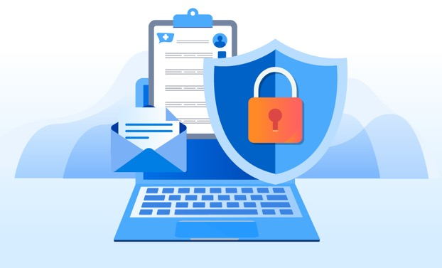
Protecting Patient Information
As a King’s Daughters Team Member, maintaining a patient's privacy is part of your job. You should access or view a person's PHI only when it is required for your job. Simply because you are able to see a person's PHI does not mean it is permissible.
King’s Daughters routinely conducts audits of access to patient records and our systems to ensure proper access by Team Members.
All patients are entitled to privacy and
confidentiality. Do your part and only look
at the Minimum Necessary information
you need to do your job.
*Privacy policies can be located on the intranet.

Slide 21
Protected Health Information
Protected Health Information (PHI) is information you create or receive in the course of providing treatment or obtaining payment for services. It includes:
information related to the past, present or future physical and/or mental health or condition of an individual; the provision of healthcare to an individual; or the past, present or future payment for the provision of healthcare; AND
at least one of the 18 personal identifiers OR there is a reasonable basis to believe the information can be used to identify the individual.
information in all formats – oral, written, electronic – including videos, photographs, x-rays, etc. - must be protected.
It DOES NOT include health information about individuals who have been deceased more than 50 years.

Slide 22
PHI Identifiers
PHI identifiers are:
  Name
  Postal Address
  All elements of dates except year
  Telephone number
  Fax number
  Email address
  URL address
  IP address
  Social Security Number
  Account numbers
  License numbers
  Medical record number
  Health plan beneficiary number
  Device identifiers & their serial numbers
  Vehicle identifiers and serial number
  Biometric identifiers
  Full face photos & other similar images
  Any other unique identifying number, code or, characteristic

Slide 23
How can PHI be used?
Providers are permitted to use or disclose PHI for:
  Treatment
  Payment
  Healthcare operations (e.g., legal, medical staff/peer review, audit, business management)
  The individual patient who is the subject of the PHI, and
  Other uses and disclosures required by law
  In all other instances, a written authorization from the patient is needed.
  Whenever in doubt about release of information, contact Medical Records Department (81821), Privacy department, (x80161 or x84451) or Legal Services (x80179) for guidance.

Slide 24
Patient Rights Under HIPAA
Right to access and receive a copy of one’s own PHI (paper or electronic format)
Right to request amendments to information
Right to request restriction of PHI uses and disclosures
Right to restrict disclosure to health plans for services self-paid in full
Right to request alternative forms of communications
Right to request an accounting of disclosures of PHI
Any questions regarding these rights, please call the Privacy Department at x80161 or x84451.

Slide 25
Privacy Tips – Reasonable Safeguards (45 C.F.R. 164.530 (c) )
Never take unsecured PHI home with you
Speak quietly in work areas
Speak quietly when discussing a patient’s condition with family members in a waiting room or other public area
Avoid using patient names, discussing cases, or other patient identifying characteristics in public areas
  We live in a small community, and even the smallest details might be identifiable to someone who overhears
Use the shred bins located throughout King’s Daughters to shred documents (that do not need to be preserved) with PHI
Always obtain at least two patient identifiers before handoff of documents or discussing patient information
Double check the mailing address to ensure the PHI is being sent to correct person

Slide 26

Privacy Monitoring
The Privacy Department has monitoring capabilities through implemented artificial intelligence and machine learning tools.
KD policies:
Confidentiality of PHI (E8)
Minimum Necessary Requirements Policy
Team Members who access medical records unrelated to their job may face corrective action including discipline, suspension, or termination of employee.

Slide 27

Examples of Inappropriate Access
Accessing records to “check on a patient” because you saw a news story about the patient and wanted to see their status
Accessing the records of a family member when you are not involved in their care
Accessing medical records of a neighbor out of curiosity
Accessing medical records of a co-worker in the hospital to “see how they are doing”
Accessing your child’s or spouse’s medical records to check their health status
Obtaining telephone numbers or demographic information without proper authorization or necessary means

Slide 28

Social Media and Patient Privacy
NEVER share identifiable information about patients on social media, for example:
  Responding to negative reviews/comments on any social media platforms
  Responding to comments on news related articles on any social media platform
  Posting of patient name/date of birth
  Posting of images and videos of patients without written consent
  Posting of gossip about patients
  Posting of any information that could allow an individual to be identified
  Sharing of photographs or images taken inside a healthcare facility in which patients or PHI are visible
  Sharing of photos, videos, or text on social media platforms within a private group
  Identifiable information can also include tattoos, birthmarks, moles, patient’s face or initials.
Considered by Privacy Department to be a high risk activity
Corrective action can include termination

Slide 29

Social Media and Patient Privacy
Common Social Media HIPAA violations:
Posting of images and videos of patients without written consent
Posting of gossip about patients
Posting of any information that could allow an individual to be identified
Sharing of photographs or images taken inside our facility in which patients or PHI are visible
Responding or commenting to negative reviews/comments from patients or news-related articles/posts about patients on any social media platform
Sharing of photos, videos, or text on social media platforms within a private group

Slide 30
Private Groups and Messages are No Exception.
Social Media and Private Groups
Sharing PHI online in a private group, private message or group chat, or other private online channel does not provide adequate protection of patient privacy.
HIPAA Privacy Rule contains only limited exceptions that permit use and disclosure of PHI without patient authorization except that which is necessary for treatment, payment, or healthcare operations (45 C.F.R. 164.506) which none of those limited exceptions apply to online disclosure.
Posting patient information online, even in private community, is problematic from a healthcare regulatory compliance perspective.
Team members discovered to have disclosed PHI are likely to face disciplinary actions and may be subject to additional discipline from your accrediting body as well as potential civil and criminal liability.
https://journal.ahima.org/page/hi-professionals-must-post-with-caution-on-social-media-to-protect-patient-privacy

Slide 31

THINK BEFORE YOU SPEAK, POST ONLINE, OR HIT SEND
Take into consideration:
  Who might be able to read this?
  Am I posting in anger?
  Could someone feel disrespected?
  Does my post include information to identify the individual?
  Am I revealing too much about myself?
  Am I showing a bad side of myself?
  Could someone misinterpret what I’m saying?

Slide 32
Examples of Breaches
Below are examples of common unauthorized uses and disclosures of PHI that must be reported to the Privacy Officer:
  Fax sent to wrong number
  Patient statements or discharge papers given to the wrong patient
  Envelopes not sealed or having the wrong mailing label affixed
  Unencrypted mobile devices or storage media
  Unauthorized patient pictures or information posted on social media websites
  Disposing of patient information incorrectly
  Accessing patient information that is not job-related
  Giving information and not obtaining information at registration process

Slide 33
Why Report Privacy Concerns?
Under the Health Information Technology for Economic and Clinical Health Act (HITECH), when a breach of patient information occurs, King’s Daughters has to notify each individual (and the federal government) and let them know their PHI has been compromised.
Due to public entity status, KD is required to complete breach notifications in accordance with the KY Data Privacy Bill – House Bill 5
There are state and federal deadlines by which KD has to provide notification, so report breaches to Privacy Officer or Compliance Officer to make sure we meet deadlines.
When King’s Daughters reports a breach, we are essentially reporting a violation of the Privacy Rule (HIPAA).
If HHS suspects that the breach or violation resulted from “willful neglect,” they will conduct a compliance review.
A fine of up to $50,000 per violation can be assigned for each HIPAA violation

Slide 34
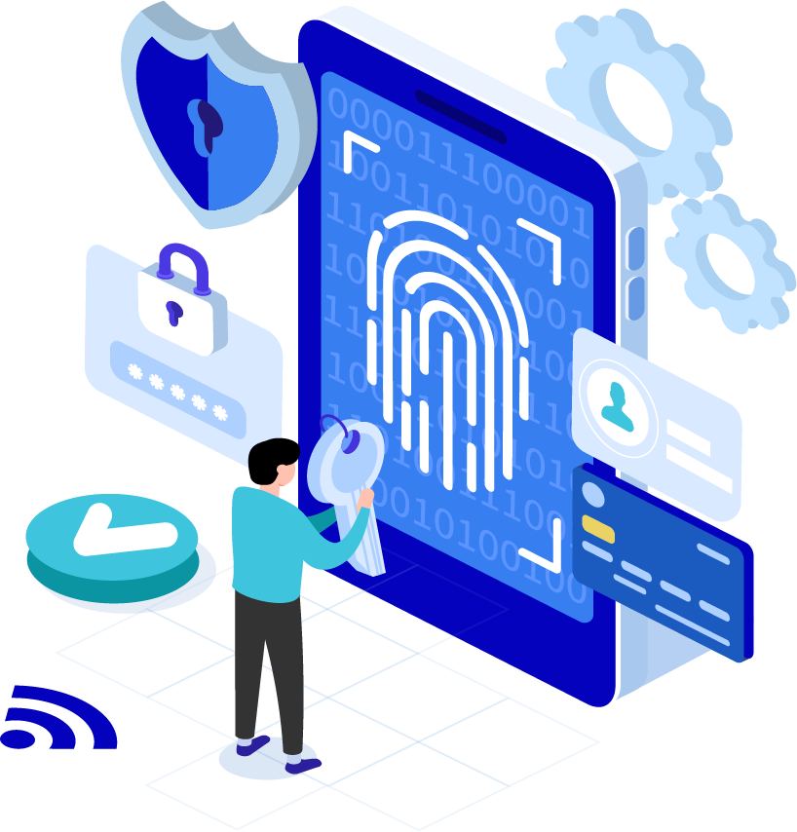
HIPAA Security Rule
A great deal of PHI is stored electronically and/or transmitted by electronic systems. The HIPAA Security Rule was created to specifically address electronic PHI (ePHI).

Slide 35
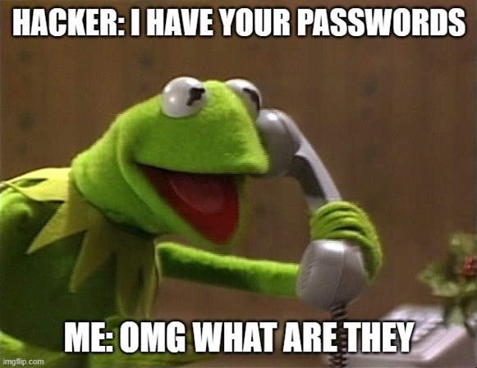
KD Password Recommendations
Passwords should be difficult to guess
Passwords should be as complex as possible
Do not use the “Remember Me” feature in Windows
12 Character Minimum
Password Change Interval = every 2 years
?

Slide 36
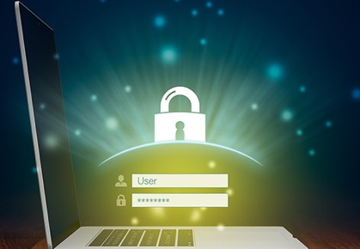
User Credentials
Only log on to computer systems with your own user ID and password. Never use someone else’s.
You will be held responsible for all activity under your user ID.
Log off from work stations when you walk away from it.
Do not share passwords, ID badges, or other access credentials with anyone.
Password complexity is an important deterrent to unauthorized access.

Slide 37
Guide to Great Security Hygiene
The following are a few common, non-technical processes that help improve your daily security hygiene. Keep in mind that the following tips aren’t isolated to work, we encourage you to apply them to your personal life and promote security awareness within your household!
Create strong, unique passwords or passphrases for every account. Great security hygiene begins with strong passwords that are at least 12 to 16 characters long and are never used for more than one account. Even better, replace your traditional passwords with passphrases, which are strings of words that make sense to you such as obscure quotes from your favorite book or song. This tactic makes them easy to remember but hard to guess.
Keep your work area clean and organized. When working in a traditional office, keep your area clean and organized. Believe it or not, messy desks qualify as security risks. It’s a lot easier to misplace sensitive materials, ID cards, and other important items if your workstation is disorganized.
Report all security incidents immediately. Where sensitive materials are concerned, always store them in a secure manner, and shred them when no longer needed. Proper disposal prevents unauthorized access to sensitive data.
Always follow KD policies. Keep in mind that despite our best efforts, security incidents may happen. So if you see something, say something immediately! The longer an incident goes unreported, the more damage it could cause. From phishing emails, to unsecured doors, every incident, even those that seem minor, should be reported immediately.
Secure your work-from-home environment (if applicable). If you work from home, remember that King’s Daughters policies still apply. Be sure to secure your work-from-home environment by keeping your devices locked when not in use and preventing other members of your household from accessing anything work related.

Slide 38
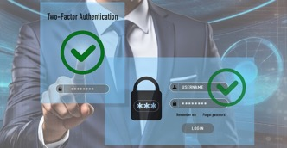
Duo Two-Factor Authentication
What is Duo Security?
Duo Security is a company that provides a cloud-based software service that utilizes two-factor authentication to ensure secure access to services and data.
What is two-factor authentication?
Two-factor authentication provides a second layer of security to any type of login, requiring extra information or a physical device to log in, in addition to your password. By requiring two different channels of authentication, we can protect user logins from remote attacks that may exploit stolen usernames and passwords.
The factors may include:
Something you know: a unique username and password.
Something you have: a smartphone with an app or SMS push to approve authentication requests.
Why do we need two-factor authentication?
Login credentials are more valuable than ever and are increasingly easy to compromise. More than 90 percent of breaches today involve compromised usernames and passwords. Two-factor authentication enhances the security of your account by using a secondary device to verify your identity. This prevents anyone but you from accessing your account, even if they know your password.
How will Duo change my log-in experience?
When logging in to an application that is protected by Duo, you will still enter your username and password. After inputting your login information, Duo requires you to complete a method of second-factor authentication.
Duo does not replace or require you to change your username and password. Think of Duo as a layer of security added to your existing log-in method.

Slide 39
What is Social Engineering?
Social engineering is the art of manipulating or deceiving you into taking an action or divulging sensitive information.
Watch out for three types of attacks:
Digital Attacks Phishing - Email-based social engineering targeting an organization. Spear Phishing - Email-based social engineering targeting a specific person or role | YOUR ROLE: STOP, LOOK, and THINK before clicking on a link or opening an attachment.
In-Person Attacks USB Attacks - An attack that uses a thumb drive to install malware on your computer. Tailgating - When a hacker bypasses physical access controls by following an authorized person inside. | YOUR ROLE: STOP, LOOK, and THINK before complying with requests from strangers who prey on your social nature. It is better to be firm than insecure.
Mobile/Phone Attacks Smishing - Text-based social engineering. Vishing - Over-the-phone-based social engineering. | YOUR ROLE: STOP, LOOK, and THINK before clicking on a link in a text message or divulging sensitive information over the phone.

Slide 40

Social Engineering: Impersonation
Impersonation is when a person plays the role of someone you are likely to trust or obey convincingly enough to fool you into allowing access to your office, to information, or to your information systems. This type of social engineering plays on our natural tendencies to believe that people are who they say they are, and to follow instructions when asked by an authority figure. It involves the conscious manipulation of a victim to obtain information without the individual realizing that a security breach is occurring.
By following some common sense rules and using your best judgement, you can defend against these attacks and better protect UK KD, yourself, and your customer’s information.
When in doubt about the validity of an individual or a request, contact your manager or the manager of the requester, for authority to comply with the request.
Ensure the physical security of your premises and don’t enable tailgating.
If you are unsure about a person’s authorization or access permission, report the situation to the appropriate staff.
Make sure you know who is in range of hearing your conversation or seeing your work.
Adopt a healthy dose of skepticism for anything out of the ordinary, especially strangers who endear themselves to you.
Never give out passwords. Technical support personnel do not ever need your password or other information related to accessing your system.

Slide 41

Email Security & Protection
Do not send confidential information in an email, in either the message or in an attachment, unless the communication line is secure and encrypted.
If you do not know the sender of an email do not open the email, if you inadvertently open the email do not open attachments or select any hyperlinks.

Slide 42
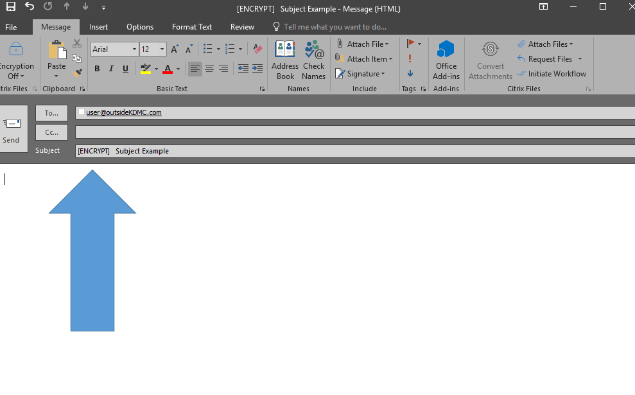
Secure Encrypted E-mail
Do not send confidential information in an external email, in either the message or in an attachment, unless the communication line is secure and encrypted.

Slide 43
Phish Alert Button
KD has installed the Phish Alert Button (PAB) in your mail client. Learn how this tool works and how you can use it to help keep King’s Daughters safe from malicious phishing emails.
When do I use it?
  Click the PAB if you believe you have received a phishing email or any potentially dangerous email. Any emails you report using the PAB will be automatically deleted from your inbox. The emails you report will be forwarded to IST Security for analysis.
  The PAB should only be used to report emails you believe to have malicious intent.
  If you are receiving spam or marketing emails, you should not use the PAB to report these. You can delete these types of emails.
Why should I use it?
  Reporting emails will help KD stay safer. Because the potential phishing emails you report are sent for analysis to IST Security, King’s Daughters will now be aware of which phishing attacks are able to reach their employee inboxes. Once we are aware of possible vulnerabilities, we can better defend against them. You are an important part of the process of keeping KD safe from cybercriminals.

Slide 44
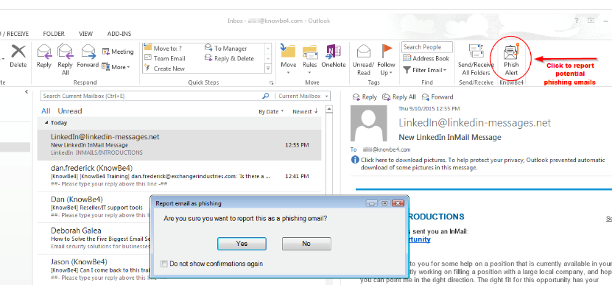
Phish Alert Button
How do I use it?
  Once the PAB add-in is installed the PAB add-in will appear at the top of your Outlook client.
In this view, to report an email as a phishing email:
Click the Phish Alert button while the email is open.
A prompt will ask you if you want to report the email as a phishing email. Click Yes to report the email, or click No to not report the email.
How To Report a Phishing Email if You DO NOT HAVE the button:
Please forward the email to: phishalert@kdmc.kdhs.us

Slide 45
Things YOU can do to avoid data breaches
If you see something strange, in the physical, cyber, or human domain, report it immediately!
Know how to recognize social engineering attacks via email, SMS, on the phone, and social media.
Mind your devices. Our lives are more mobile than ever thanks to smartphones and tablets. Where we go, our information goes.
Always keep your technology with you when you are not in the office. We live a mobile life and security is absolutely essential!
Use common sense while on the internet, using email and social networks.

Slide 46
IST Security Team
David McDonald, Chief Information Security Officer - ext. 89139
Jason Fox, Cybersecurity Analyst - ext. 89134
Alan Clark, Cybersecurity Analyst - ext. 89137
Mike McDaniel, Cybersecurity Analyst - ext. 89083

Slide 47
Code of Conduct
Code of Conduct
Guide which supports day-to-day decision making with KD's standards of professional conduct
Essential element of KD’s Compliance & Integrity Program
A commitment by each team member, provider, vendor, contractor, board member, and volunteers
Identifies KD’s mission, values and principles with standards of professional behavior and ethics
Compliance Mottos:
“Do the Right Thing!”
“See it, say it, fix it!”

Slide 48
Code of Conduct
King’s Daughters is committed to honest and ethical behavior and to conducting our business with integrity. The practice of behaving honestly, ethically and with integrity is an individual responsibility. We make decisions about how to conduct ourselves every day as we go about our work. Each of us is accountable for the actions that we choose to take.
The Code of Conduct is the keystone of its corporate integrity philosophy and communicates its ethical business standards. The Code of Conduct serves as a cultural compass for team members, management, vendors/contractors, volunteers and others who interact with King’s Daughters and all subsidiaries. It is an essential element of our Compliance & Integrity Program.
The Compliance & Integrity Department oversees the King’s Daughters Compliance & Integrity Program and ensures the subsidiaries maintains its commitment to conducting our business with integrity. The Compliance & Integrity Program is a partnership among all of us to make the right business choices.

Slide 49
Conflicts of Interest
TM may not use their positions to profit personally at the expense of King’s Daughters and subsidiaries.
Examples of Potential Conflicts:
Provide consulting services to competitor
Responsible for purchasing medical devices and you own a medical device company
Directly supervising a close family member or in a position to make decisions to benefit the family member
Team members are obligated to report potential conflicts of interest:
Upon hiring / on boarding process (conducted by HR)
Any time a conflict develops
During annual compliance training
Sources of Conflict of Interest
Financial
Professional
Personal
Prejudicial

Slide 50

Gifts and Gratuities
King’s Daughters Code of Conduct identifies:
Team members may accept unsolicited business courtesies from vendors, excluding cash, up to $50.00.
  For this reason, we are most often unable to accept vendor offers for complimentary conference attendance.
Team members and contracted providers may accept an unsolicited gift, excluding cash, from a patient or a patient’s family member of less than $100.00.
NOTE: MasterCard and/or Visa gift cards are considered cash.
Examples of acceptable gifts are:
                $25.00 gift cards for Starbucks, Texas Roadhouse, Cheddars
                $50.00 Cinemark movie pass
                Flower arrangement, candle
                Edible Arrangements bouquet, a cake from Tipton’s or cookies from Sweet Caroline’s

Slide 51

Gifts to Medical Staff and/or Immediate Family
Non-monetary compensation to physicians and their immediate family is regulated by CMS
Examples of non-monetary compensation are: non-working meals, gift baskets, physician appreciation events, holiday parties, sporting events
Physicians services tracks non-monetary compensation to physicians
$507 annual limit for 2024; 2025 annual limit will be released in January
Please report any gift to a provider or provider family member to your supervisor/manager/director, Physician Services, or Compliance and Integrity

Slide 52


Nondiscrimination for Programs and Activities
UK KD complies with applicable federal civil rights laws including 1557 of the Affordable Care Act
UK KD does not discriminate on the basis of race, color, national origin, sex, age, or disability.
UK KD provides language assistance services and appropriate auxiliary aids and services for individuals with limited English proficiency, visual impairment and/or hearing impairment.
Team members and physicians should ONLY provide interpretation services in emergent situations – utilize the services listed below in the ordinary course of business:
  Propio, Interpreting Services of the Commonwealth, and Deaf Services Center provide over the phone and video interpreting.
  Refer to Interpreters Policy for guidance
Contact:
Kati Collins,
Civil Rights 1557 Coordinator ext. 81964

Slide 53
Workplace Sexual Harassment
King’s Daughters strives to maintain a workplace that fosters mutual team member’s respect and promotes harmonious, productive working relationships. In providing a productive working environment, King’s Daughters believes that its team members should be able to enjoy a workplace free from all forms of discrimination, including harassment on the basis of race, color, religion, gender, national origin, age, disability, veteran status, uniformed service, marital status, pregnancy, sexual orientation, gender identity, or any other status or characteristic protected by law.
It is King’s Daughters policy to provide an environment free from such harassment.
It is a violation of policy for any team member, whether a manager, supervisor or co-worker, to harass another team member. Harassment of third parties by King’s Daughters team members, or harassment by third parties of King’s Daughters team members, is also prohibited.
Please report suspected or violations to the Human Resource Department, supervisor, manager, director, or to the Compliance and Integrity Department.

Slide 54
Conflict vs Bullying
Conflict
Bullying
Disagreement or argument in which both sides express their views
Equal power – mutual engagement
Equal emotional reaction
Happens occasionally
Can be accidental
Not seeking power or attention
Feelings of remorse and responsibility
Effort to solve problem
Goal is to hurt, harm, or humiliate the victim
Imbalance of power – one sided
Strong emotional reaction from victim
Happens repeatedly
Intentional, threatening
Seeking power and control
No remorse – blames victim
No attempt to stop

Slide 55
What to do
If you feel that you are being bullied, discriminated against, victimized or subjected to any form of harassment:
DO
  Firmly tell the person that his or her behavior is not acceptable and ask them to stop. You can ask a person you trust, such as a supervisor or team member to be with you when you approach the person.
  Document the events in RL6 reporting system. Record:
    The date, time, and what happened in as much detail as possible
    The names of witnesses
    The outcome of the event
  Remember, it is not just the character of the incidents, but intent of the behavior and the number, frequency, and especially the pattern that can reveal bullying or harassment
  Keep copies of any letters, memos, e-mails, etc., received from the person
  Please report suspected or violations to the Human Resource Department, supervisor, manager, director, Risk Management Department, or to the Compliance and Integrity Department
  If your concerns are minimized, proceed to the next level of management
DO NOT RETALIATE. You may end up looking like the perpetrator and will most certainly cause confusion for those responsible for evaluating and responding to the situation.

Slide 56

Abuse
Abuse, neglect, exploitation know no boundaries. Any patient, at any age can become a victim, although people who depend on others for their emotional and physical health are at high risk.
Everyone has a responsibility to immediately report suspected cases of abuse, neglect, domestic violence, sexual assault, or exploitation to Social Services.
Social worker is on call 24/7 and can be reached through the switch board operator.

Slide 57

How do I report suspected compliance violations?
All King’s Daughters team members, providers, and contractors/vendors are required to report concerns about actual, potential or perceived misconduct to the Compliance & Integrity Department. One may use any of the following reporting tools:
Call the Compliance Hotline at (606) 408-4145 or (877) 327-4145;
Call the Lighthouse Services Hotline at (844) 940-0003 which is an independent third-party hotline provider contracted by King’s Daughters as an additional anonymous reporting tool;
Complete the Compliance Concern Form found on the intranet;
Contact Compliance team, Tonia Hall @ (606) 408-4451 or Heather Marcum @ (606) 408-0161;
Contact your supervisor, director or Vice President;
Email corporatecompliance@kdmc.kdhs.us (not anonymous);
Send written correspondence intercompany to 2201 Lexington Avenue, Ashland, KY 41101 Attn: Compliance & Integrity Department.

Slide 58

In Conclusion…
Compliance can be summarized in a short phrase…

Slide 59
Thank you for viewing this presentation.
Please complete the following items to receive credit for this course:
General Compliance Training & Post-Test (upper right corner of this screen)
Conflict of Interest (on your KDHSU To Do List)

